Slide 1
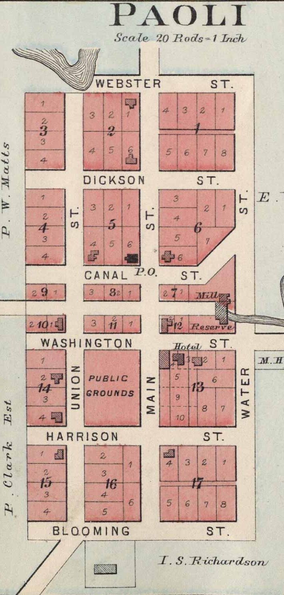
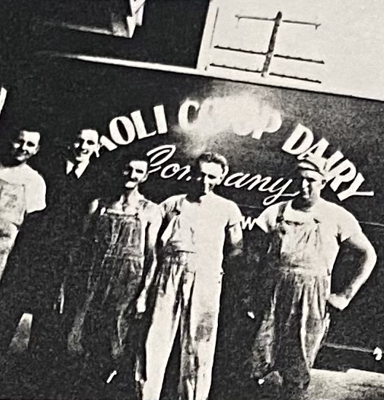
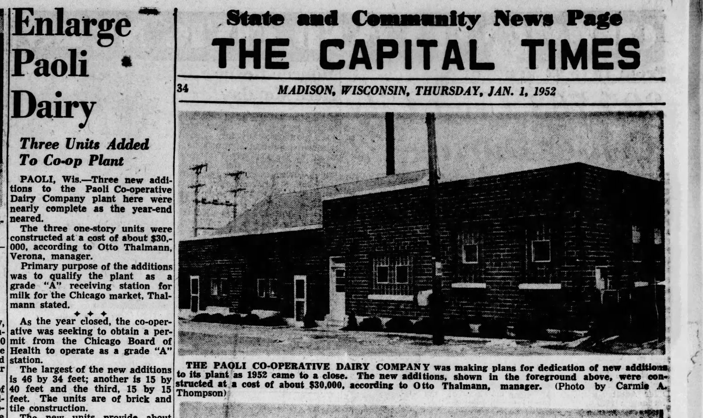
PRESERVING BUILDINGS AND STORIES AT A DANE COUNTY DAIRY FACTORY
Nic Mink
Chief Restoration Officer
Seven Acre Dairy Company

Slide 2
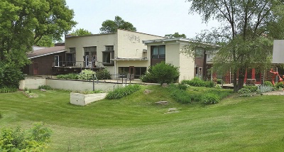
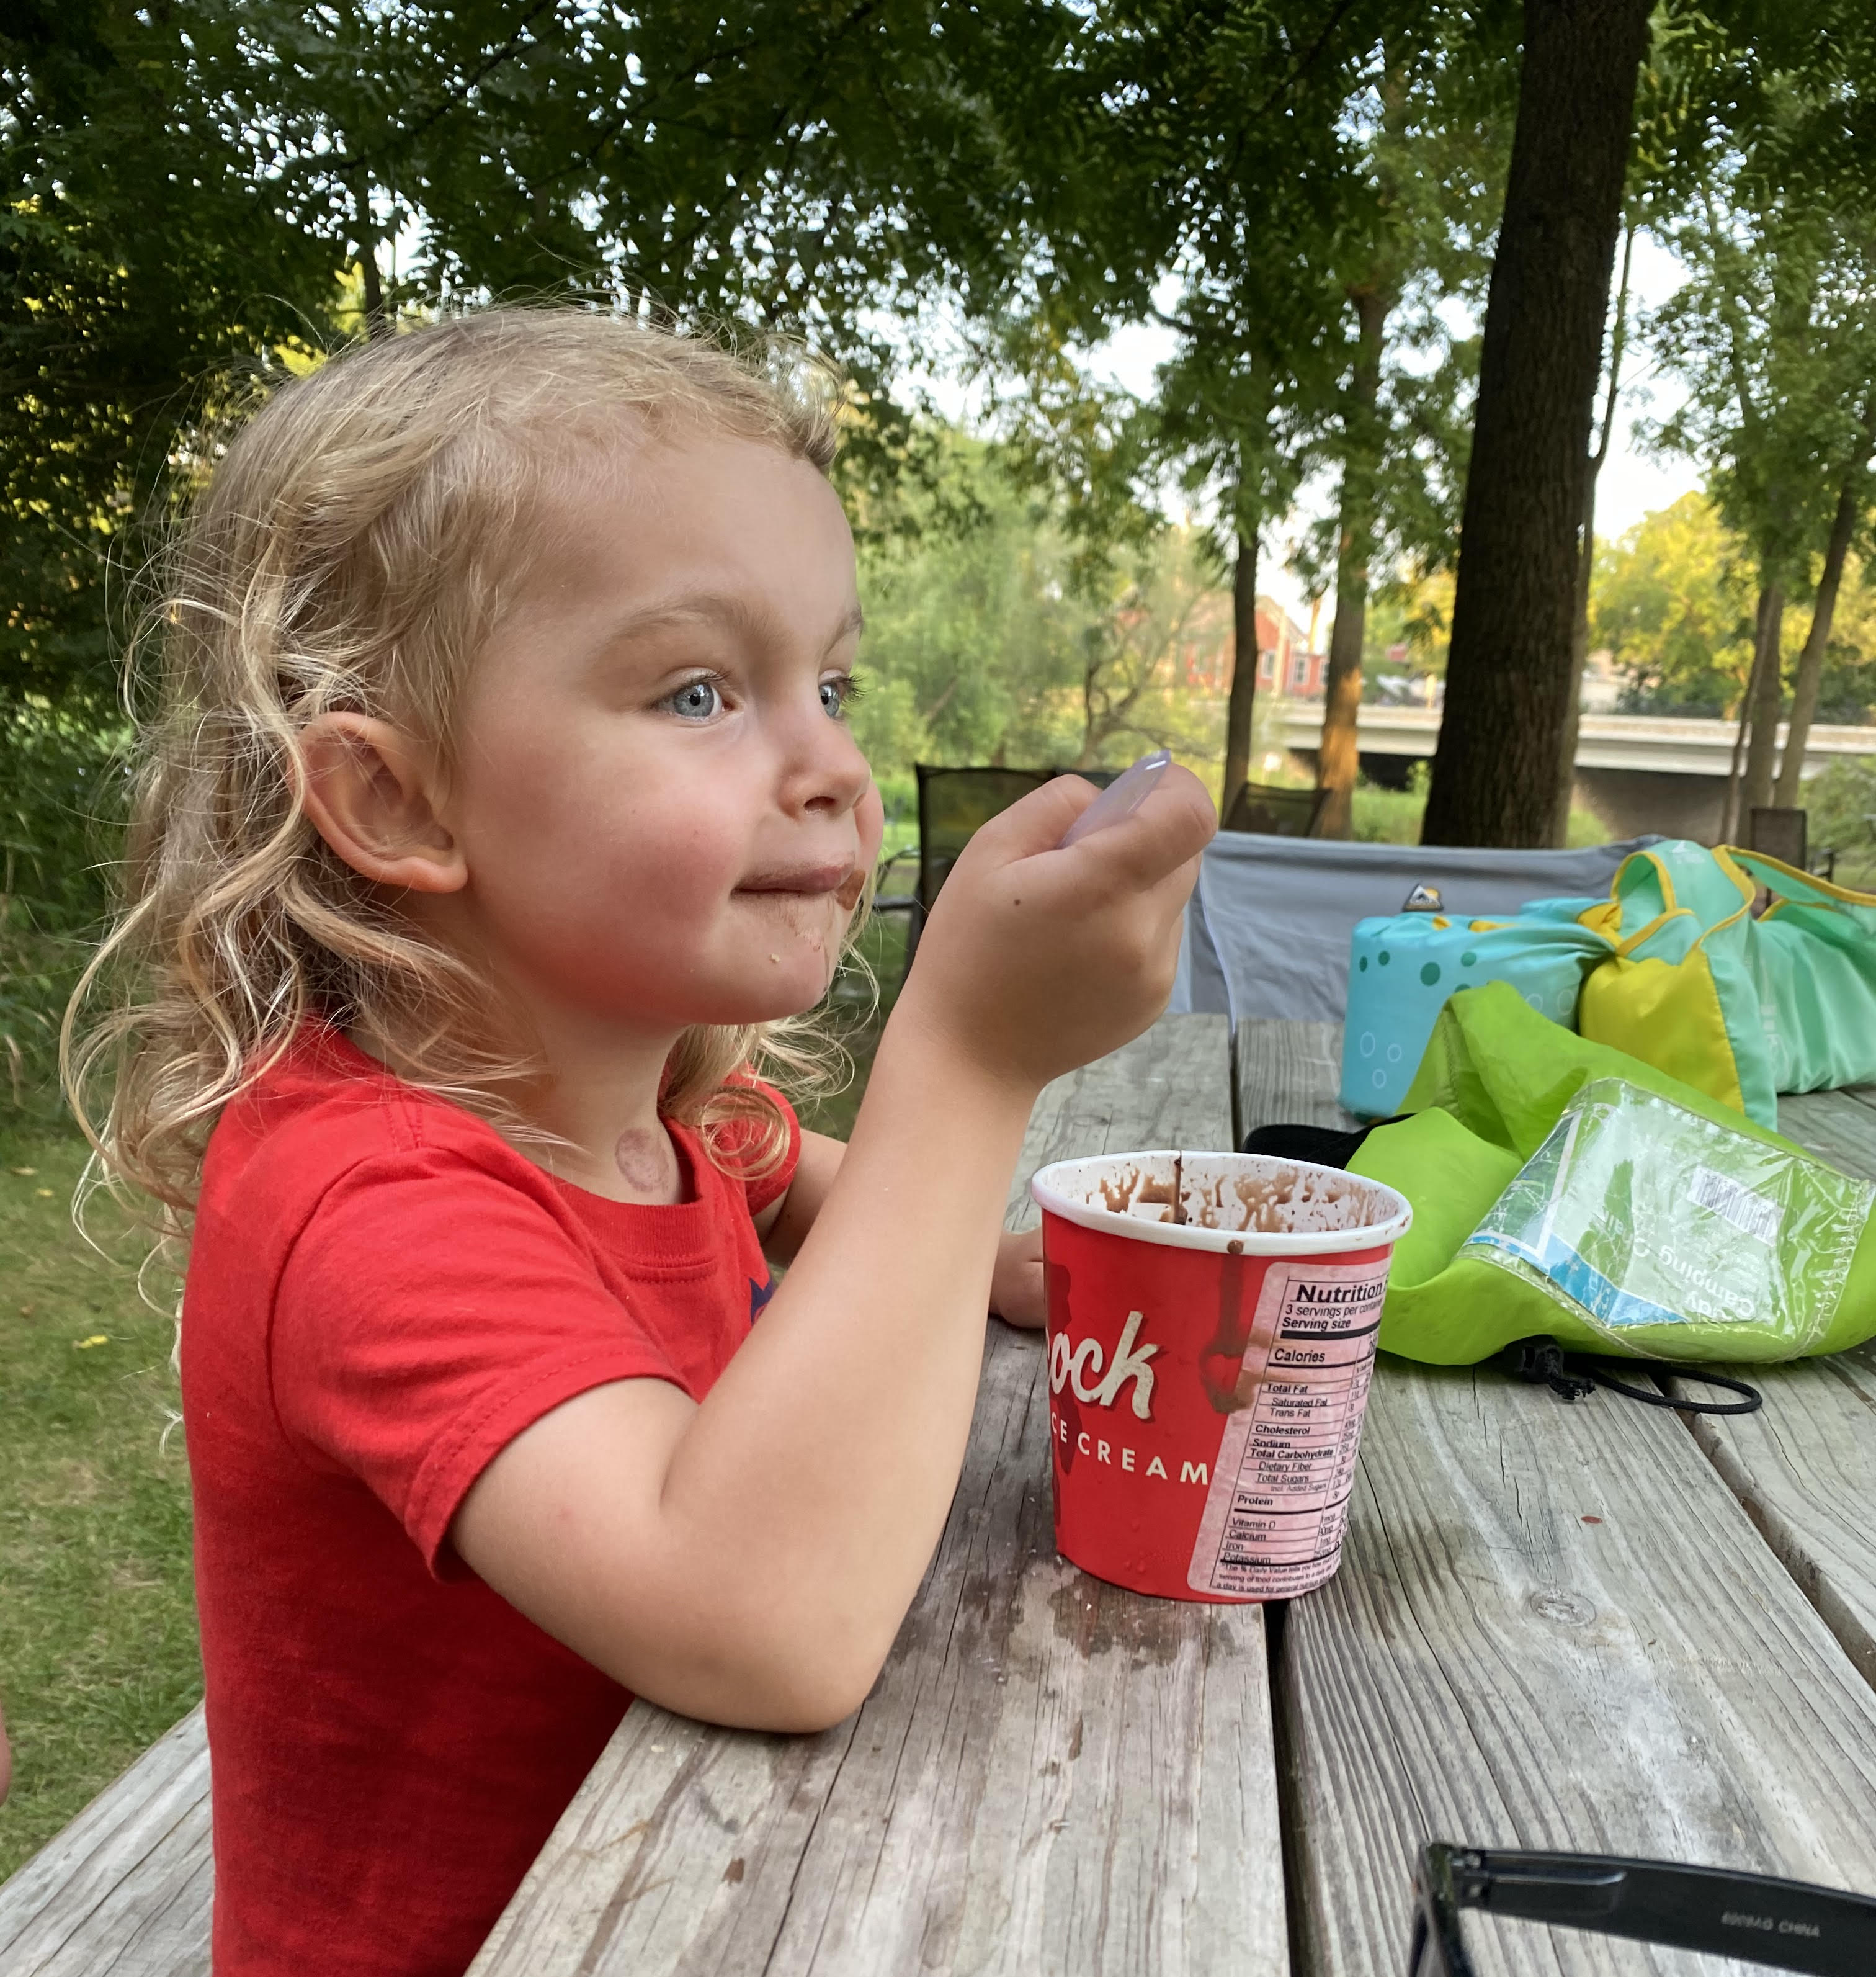
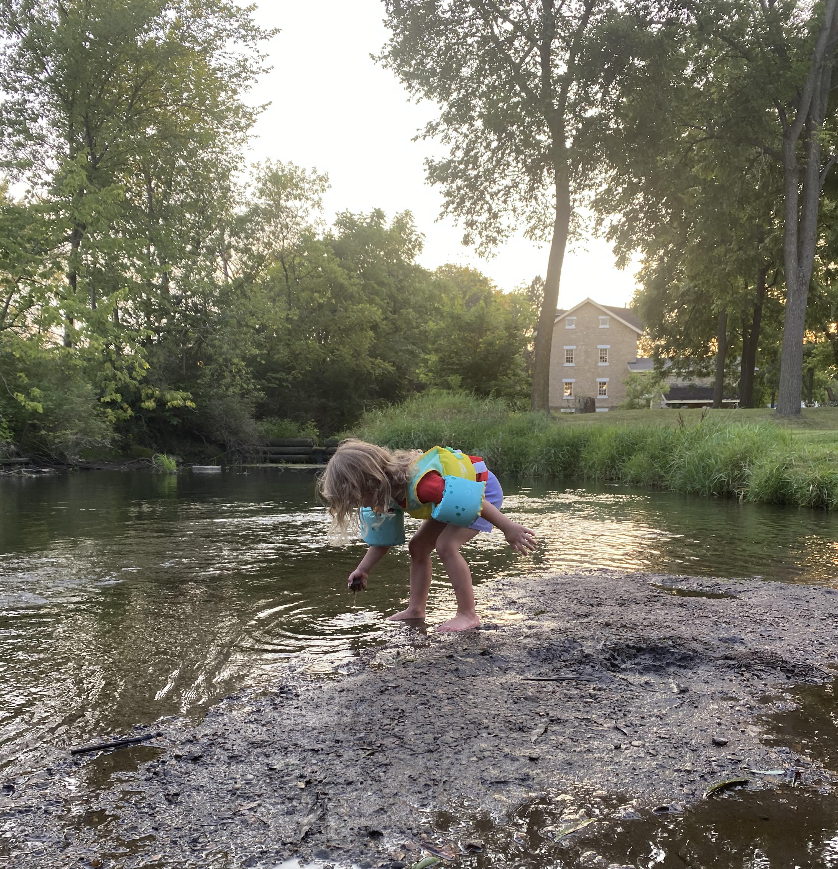
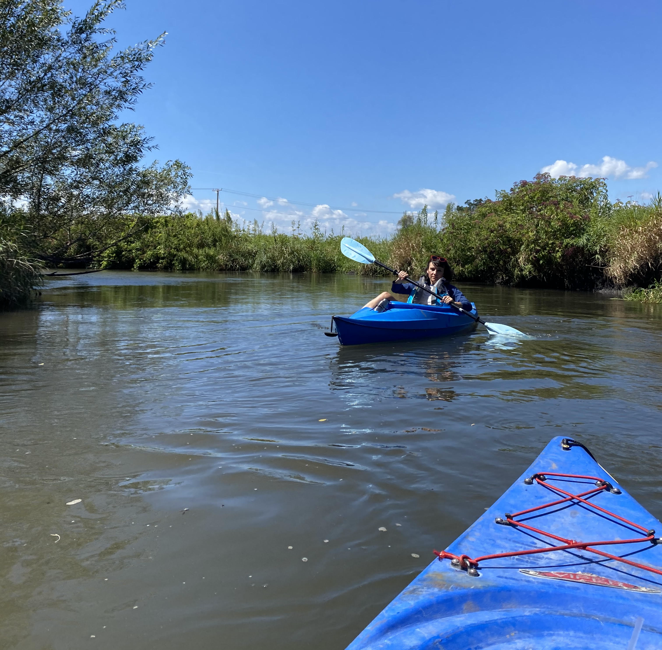

Slide 3
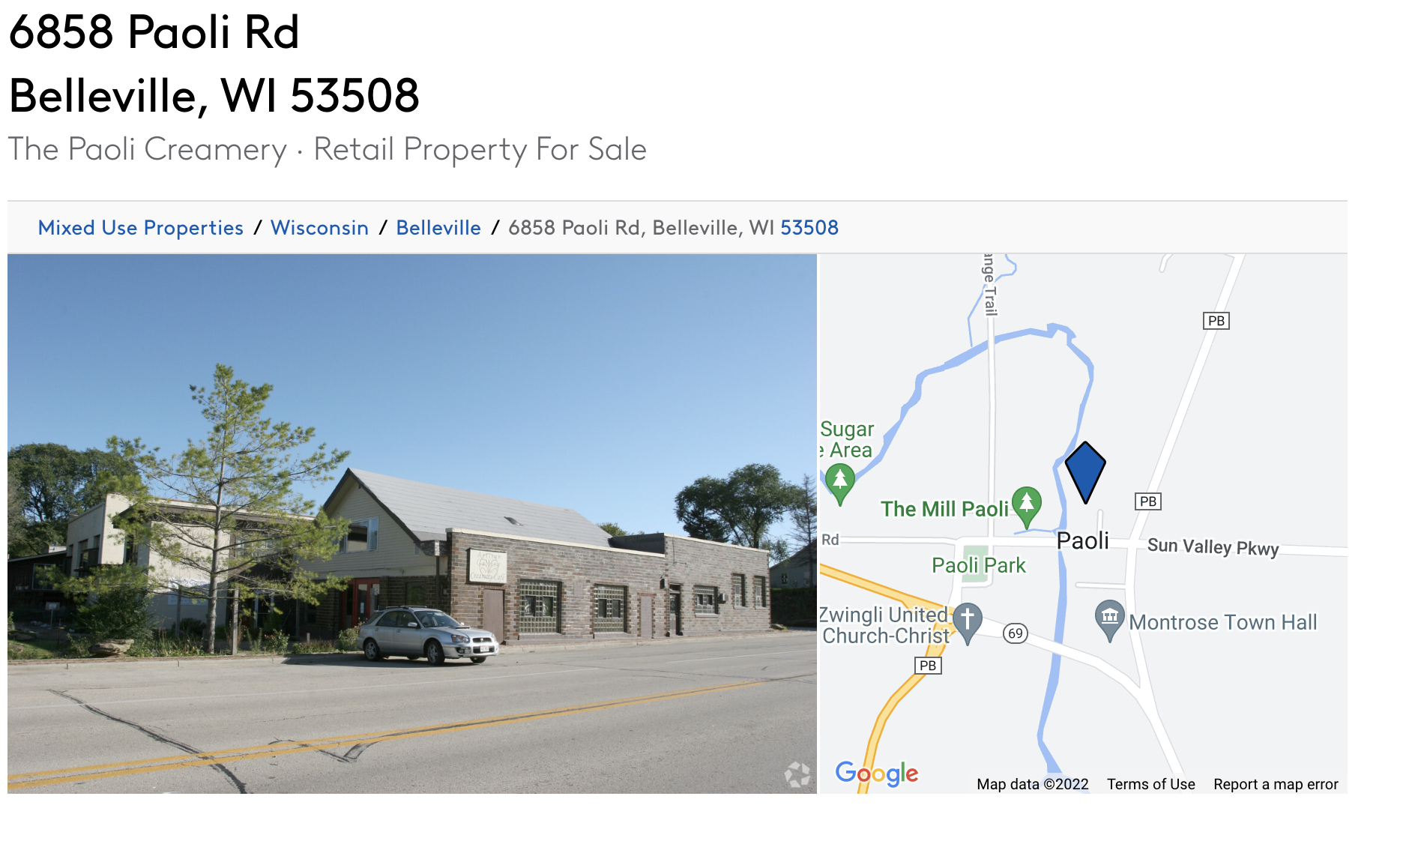
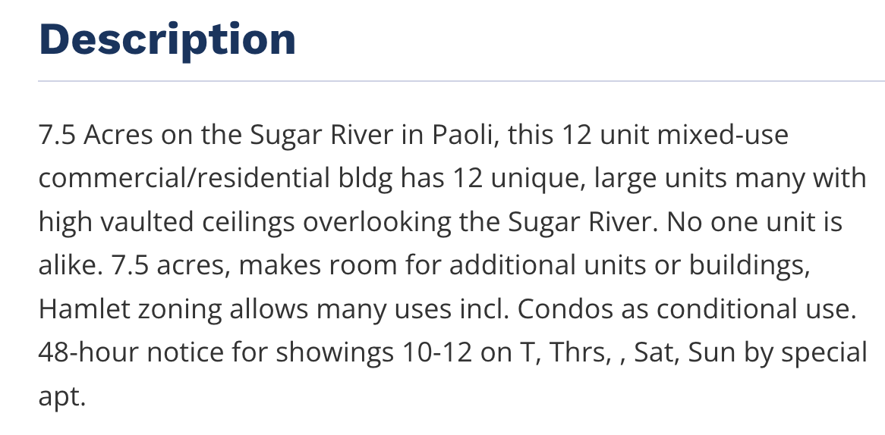

Slide 4
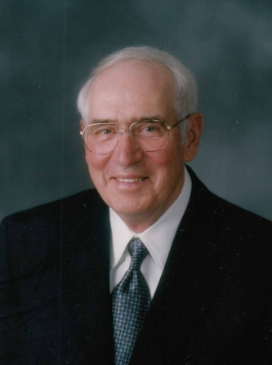
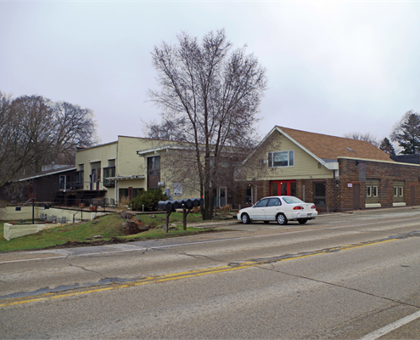

Slide 5
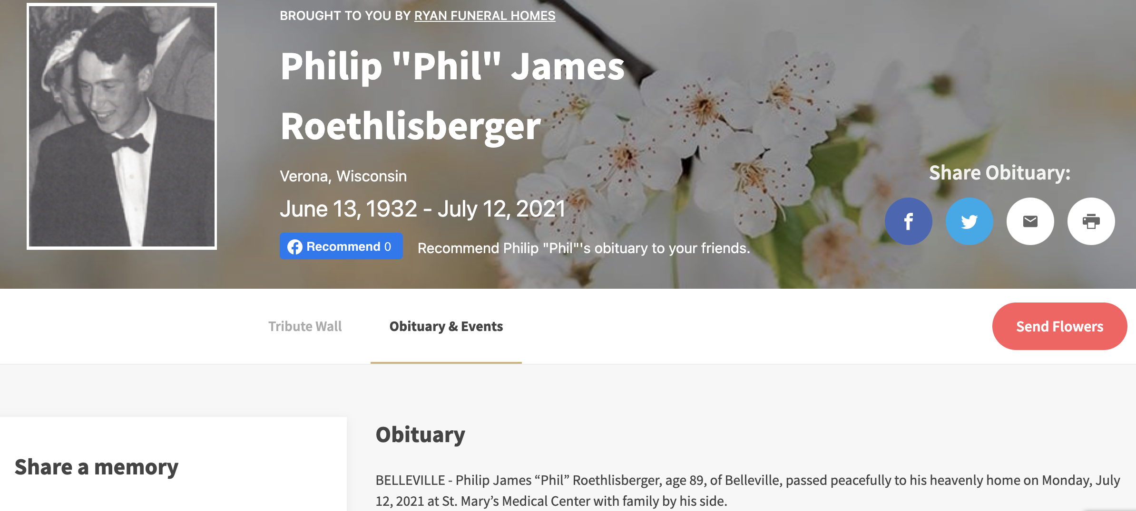

Slide 6
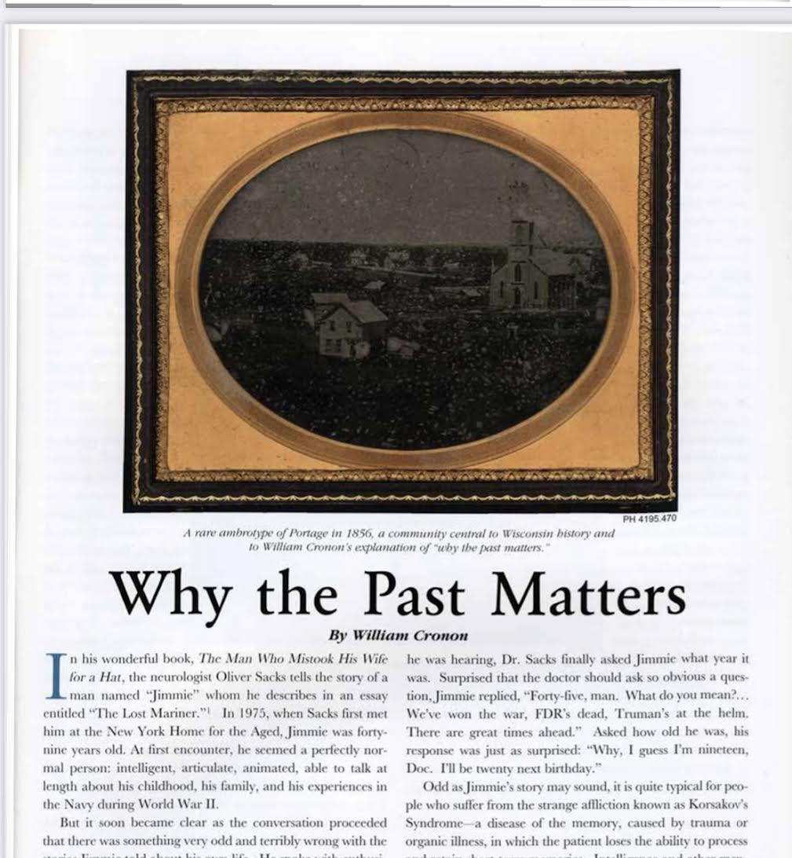
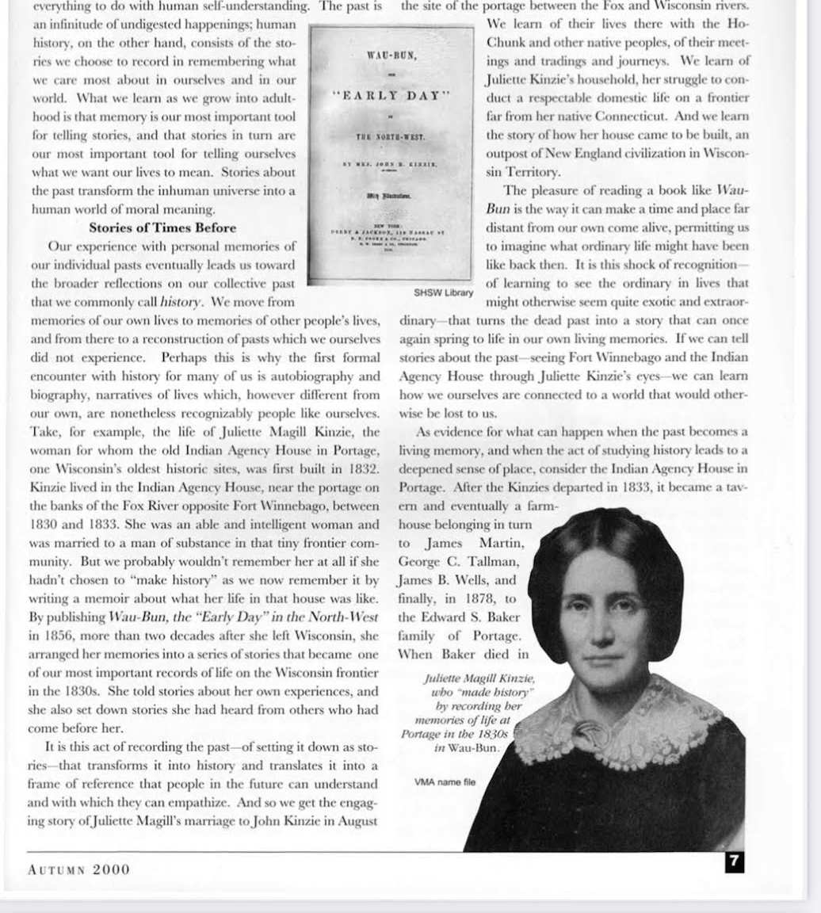
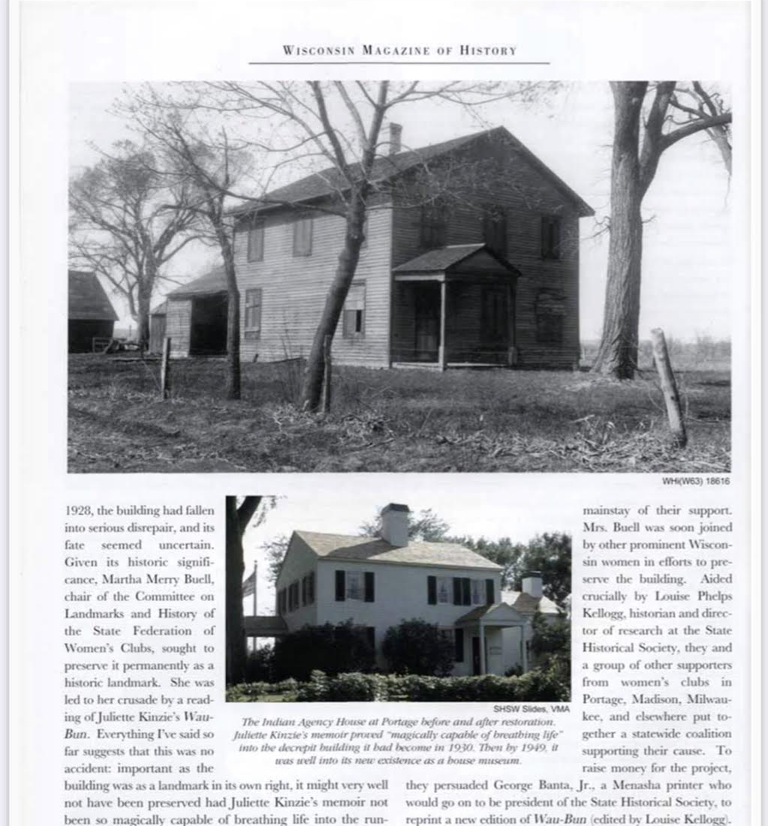
Two Important points:
  Personal memories become stories and, stories, when shared collectively become history, a type of story that centers our lives and helps us figure out who we are
  These stories about the past have immense power to change the present, as was the case with Juliette Kinzie’s Wau-Bun, whose memoir sparked the preservation of the Indian Agency House

Slide 7

Powerful meditation of stories, life, and death
Our true death happens– “The Final Death”-–in the words of Hector, when people in the living world stop telling stores about those who have entered the after life.

Slide 8
Could we take these fading stories and disappearing memories, build a collective history, and use this building and its businesses to be the caretakers of this history?
A Potential Ofrenda to 20th century dairy

Slide 9
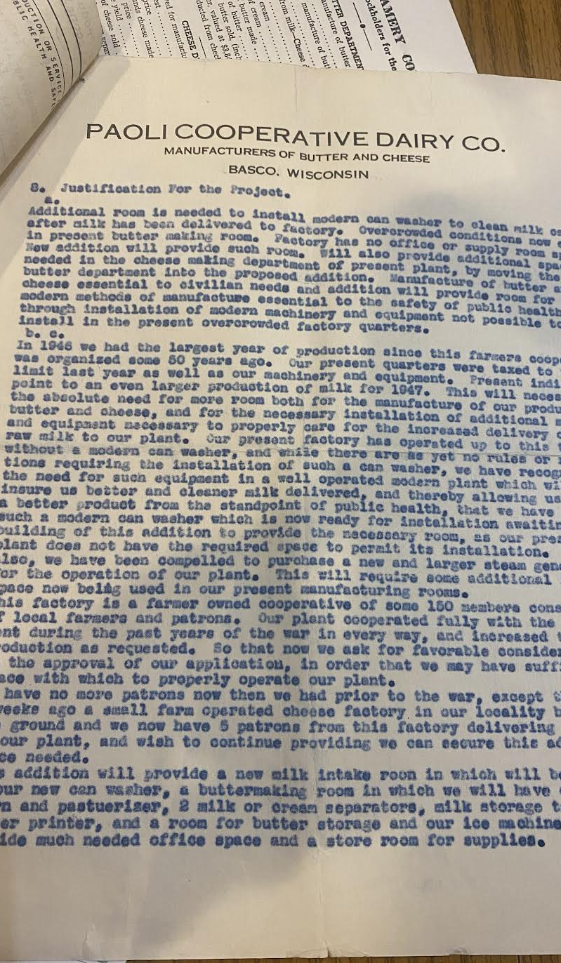
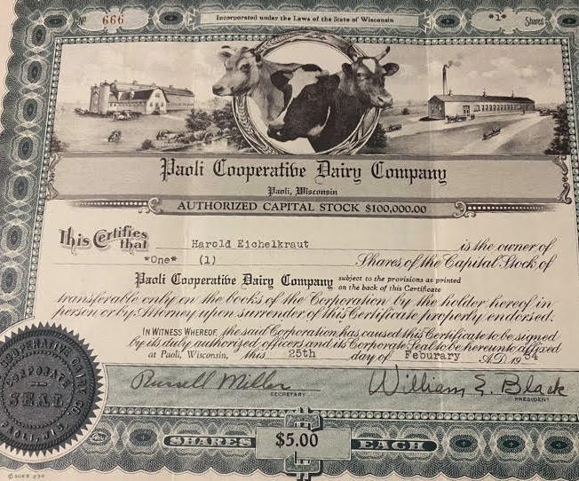
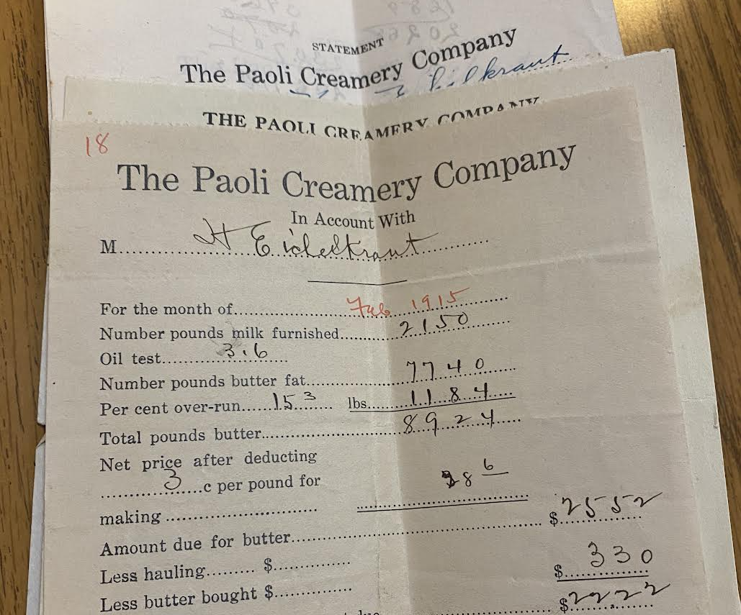
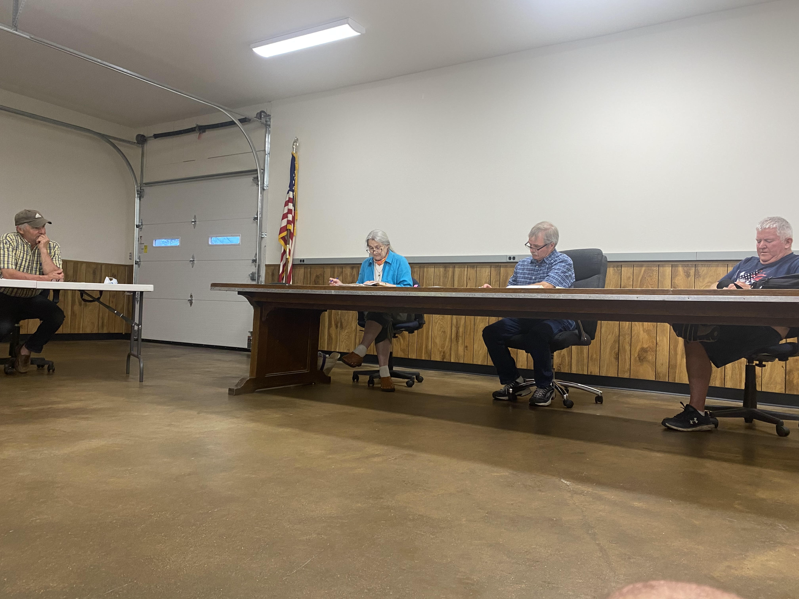
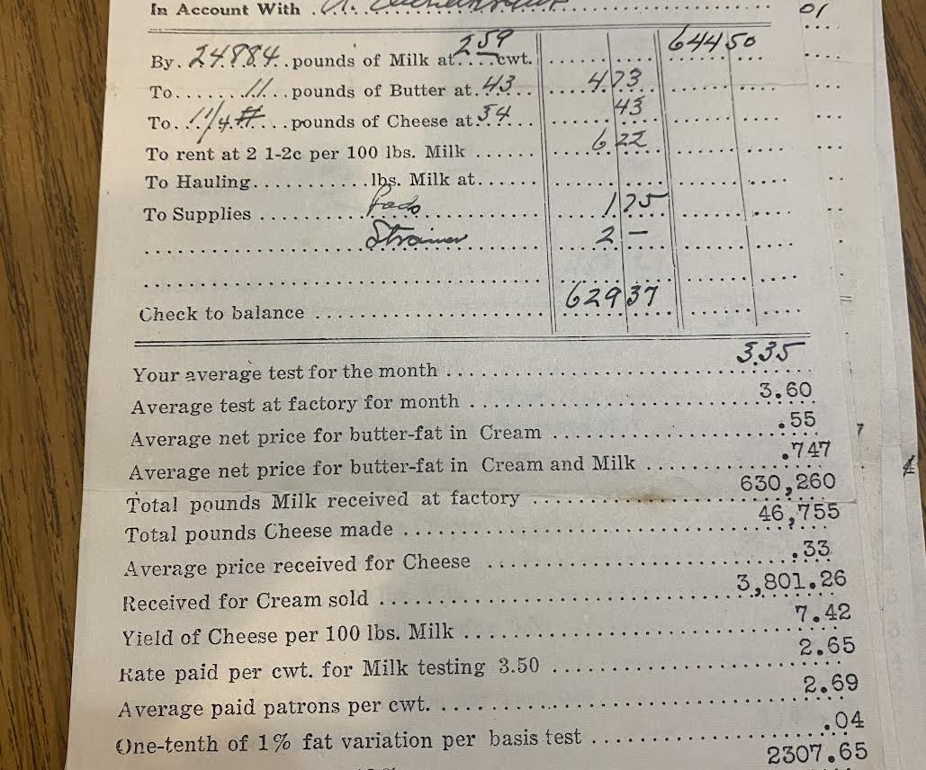

Slide 10
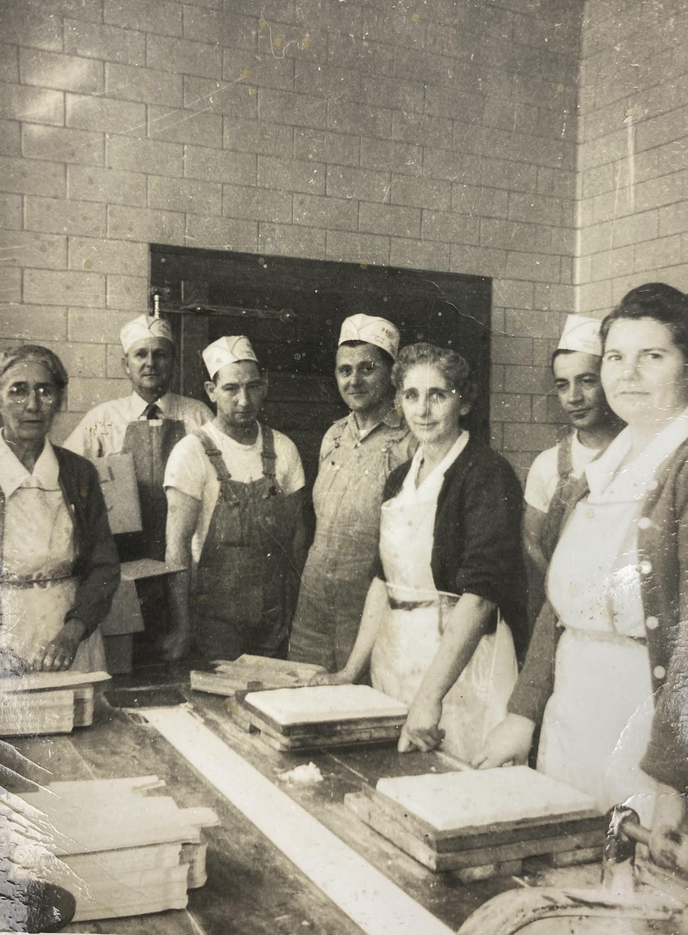
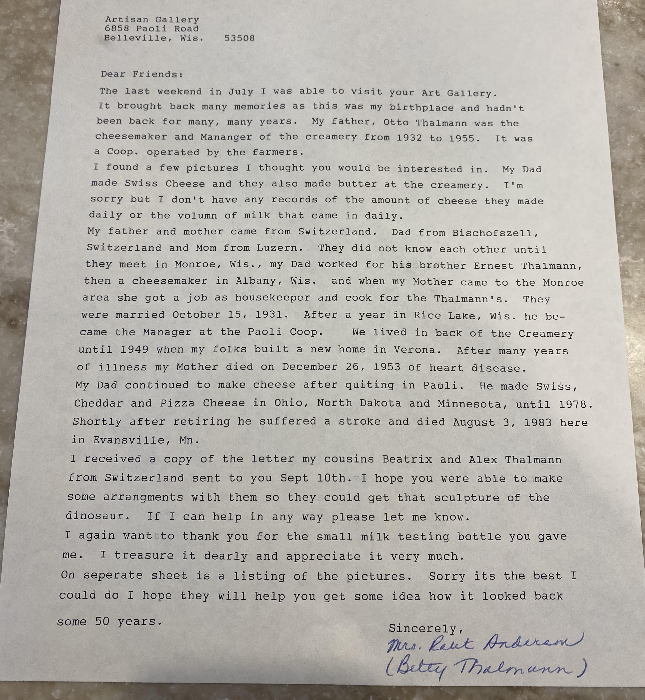

Slide 11
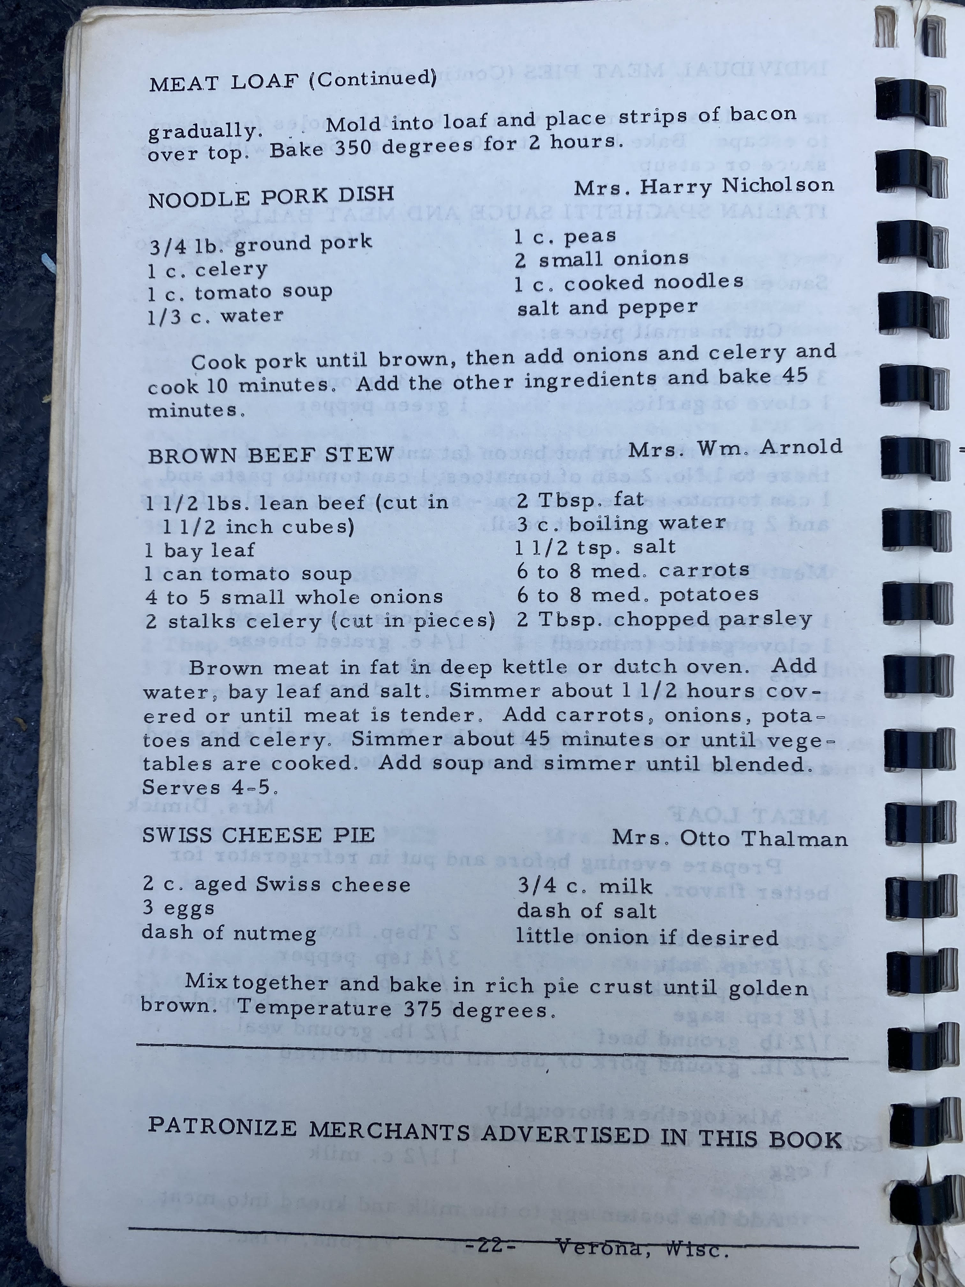
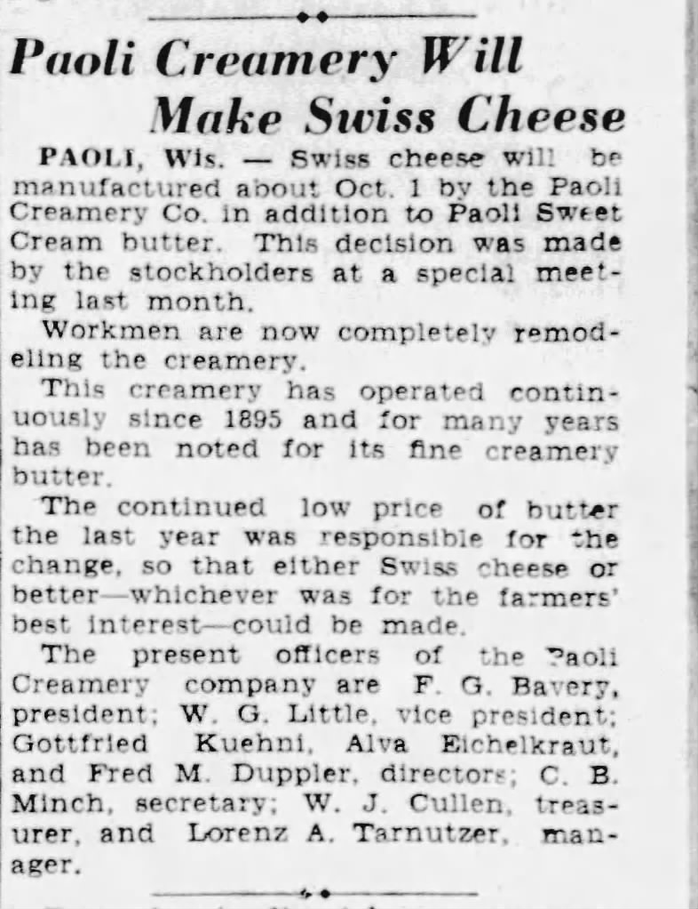
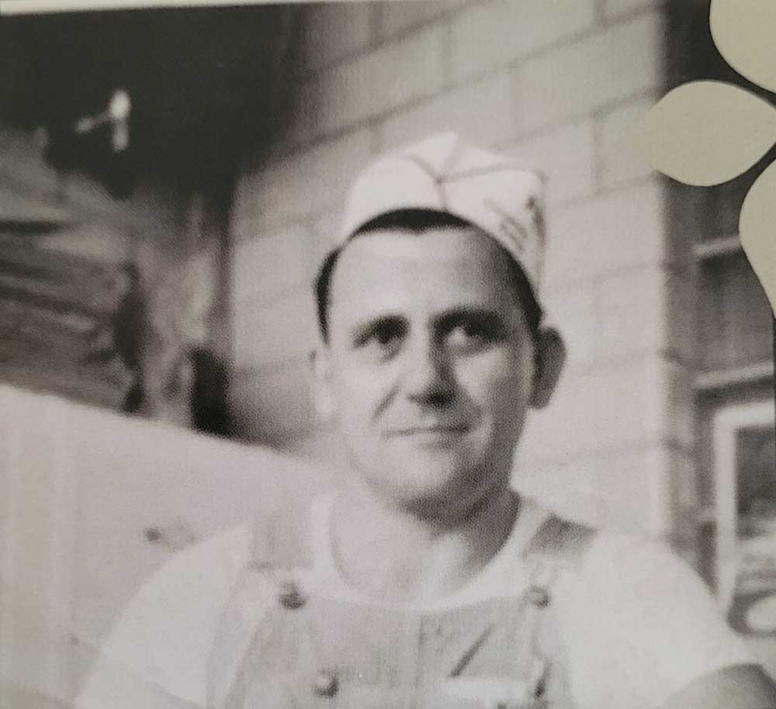

Slide 12
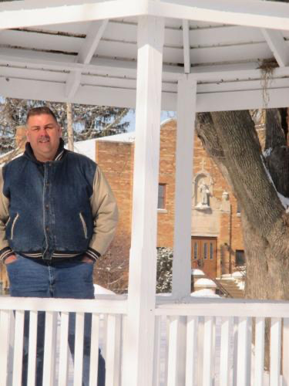
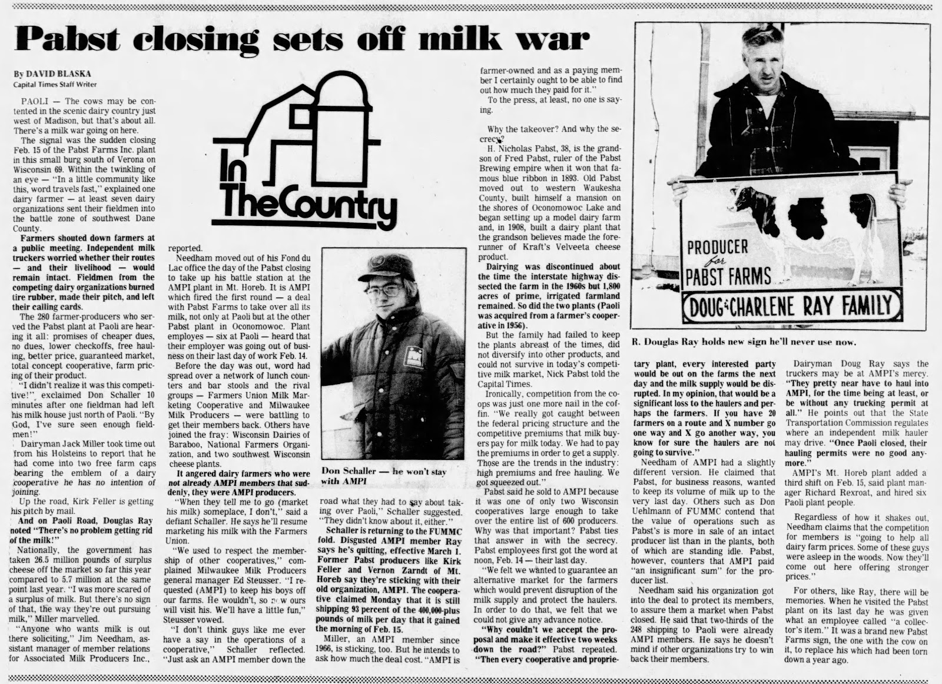

Slide 13
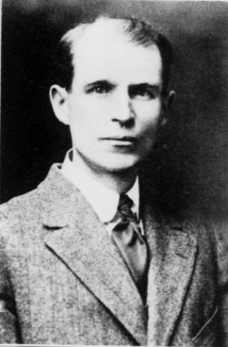
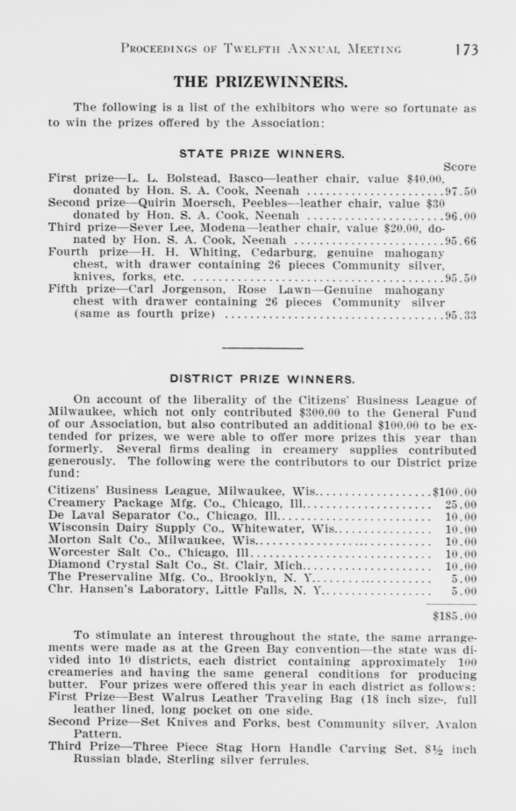

Slide 14
Memories → History → National Register
The Dairy Plant at the site operated continuously between 1888 and 1980.
The factory would provide a critical outlet for local, farmers, sometimes allowing them to access larger markets by processing their milk into both cheese and butter that could be shipped more easily.
The factory expanded rapidly during the middle of the twentieth century, reflecting the growing importance of dairy to the state and the essential role the facility played in the local community. Workers constructed additions to the factory in the 1920s and 1930s, allowing the facility to be able to produce both Swiss cheese and butter, depending on market conditions. The butter and Swiss made at the plant was some of the best in the state, at times, the nation.
In the early 1950s, the factory, then known as the Paoli Cooperative Dairy Company, embarked on its most significant expansion: a new wing dedicated to Grade “A” fluid milk. Licensed by the Chicago Board of Health, this fluid milk facility allowed the region’s farmers to access the Chicagoland marketplace.
Pabst, Inc. purchased the factory to access to additional milk for processing into baby formula in Oconomowoc. In 1980, in large part because of the rapid consolidation and industrialization of the industry.
These Memories become official collective history through National Register of Historic Places Approval November 18, 2022, nearly a 1.5 year process of discovery. The building is on the register an exceptional example of the contours of change in Wisconsin’s dairy industry over nearly 100 years.

Slide 15
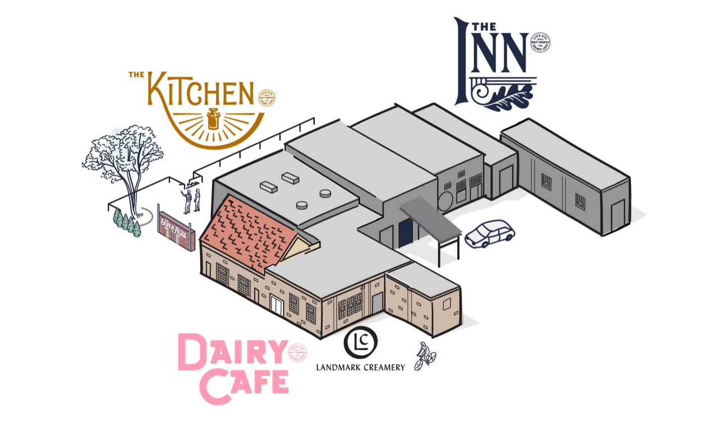

Build Businesses inside the “historic” structure to make it living and to reanimate the space…becomes Seven Acre Dairy Company
Businesses become the vehicle where the stories will be repeated and cemented as the community’s collective history.
Customer become Caretakers

Slide 16
Come Hang and Be One of The Caretakers of this Story and of Our Collective History nicmink@gmail.com

