Slide 1
PAYMENT TRENDS
Presenter: Melissa Fellows
October 10, 2022

Slide 2
Agenda
Current Payment Trends
  Industry
  At First Business Bank
Real Time Payments
  What’s coming
Integrated Payables with Virtual Card Payments
  Overview
  Sample ROI
Open Q & A

Slide 3
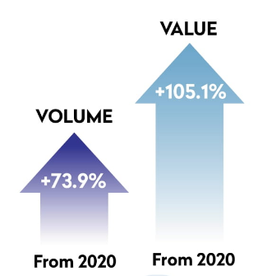
Payment Solutions
Check Volumes
  33% of organizations’ B2B payments in U.S. and Canada continue to be made by check. Down 9% from the 42% reported in 2019.
  Total check volume:
    Decline from 2019 to 2020 - 14%
    Decline from 2020 to 2021 - 2.9%
  Speed of payment is vital today to maintain strong supplier relationships with supply chain disruption
ACH
  Significant growth in 2021 with 29.1 billion payments valued at $72.6 trillion
  Total ACH volumes are up 8.7% over 2020
  B2B payments reflect a 20.4% increase from 2020, as the pandemic fast-tracked businesses’ switch to ACH payments.
Same Day ACH
  5th year anniversary of Same Day ACH
  Operating hours for Same Day ACH were extended in March of 2021
  Latest Same Day ACH enhancement increased the per payment limit to $1million per transaction
International ACH (IAT)
  Cross-border payments to 33 countries including Canada, Mexico, Panama and 30 European countries
Sources: https://www.federalreserve.gov/paymentsystems/check , www.NACHA.Org

Slide 4
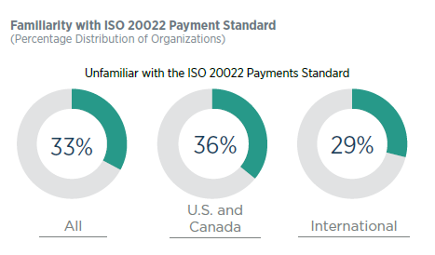
Payment Solutions
Wire
  Same day settlement, generally within a few hours
  No value limit
  More expensive when compared to ACH and Check and irrevocable
  Wire volumes showing annual volume growth with 11.1% in 2021 and 9.8% in 2020
ISO 20022 And Payment Files/Reports can be defined as a global dictionary of standardized messages that can be used for payments.
  New payment systems developed for U.S. Businesses will most likely be based on this standard
Source: www.AFPonline.org

Slide 5
TRENDS AT FIRST BUSINESS BANK
Year over year business check payment volumes have declined 5.4%
Year over year ACH Origination volume has increased 10.4%
Experienced consecutive quarter over quarter double digit growth with mobile user adoption for consumer and businesses
10% increase in wire volume split evenly between incoming and outgoing wires
Heightened interest and growth in lockbox

Slide 6
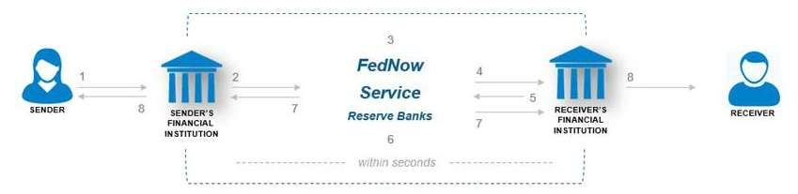
Real Time Payments
Real Time Payments – payments that are initiated and settled nearly instantly. RTP networks provide 24x7x365 access
    The Clearing House - RTP
    Zelle
    FedNow Service – Faster Payments (Coming 2023)
FedNow will allow financial institutions of every size and in every community provide a safe and efficient instant payment service
Bank Routing and Bank Account information will be required for payments (transaction limitations)
Ability to request a payment
Source: https://www.frbservices.org/financial-services/fednow

Slide 7
Corporate Card Solutions
Corporate Credit Card
  Corporate liability with Company Bill or Individual Bill
  Online access, activity, mobile functionality
    Real-time card limit changes, request new cards
  Can be used for travel & expense
  Expense Reporting Systems integration (Ex: Concur, Expensify)
  No cost, 1% rebate
Purchase Card Program
  Corporate liability with Company Bill or Individual Bill
  More robust online platform with GL coding and custom reporting
  Can have one program for business expenses and T&E
  Generally no cost, rebate programs are tiered
Virtual Card Program (vCard) / Single Use Accounts
  No plastic issued
  One-time use 16-digit credit card number with exact amount, issue, expiration and CVV
  Vendor receives email notice to process payment or receives in straight through processing
Card Program Benefits
      Low or no cost
      Rebate
      Improve working capital
      Security

Slide 8
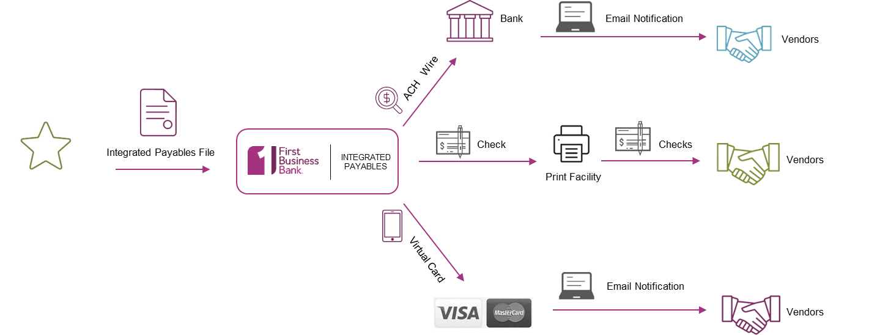
Integrated Payables
Take a file from your accounting system and execute AP payments as check, ACH, wire or virtual card through a single online portal

Slide 9
How can Integrated Payables help?
REDUCE EXPENSES / PAPER
Migrate check payments to electronic payments thereby reducing costs and eliminating paper
IMPROVE WORKING CAPITAL / DAYS PAYABLE OUTSTANDING
Pay with vCard, allowing your customers to hold on to cash longer
MITIGATE FRAUD & RISK
Leverage a vendor portal to store bank account information; reduce risk-laden paper checks
OUTSOURCE NON-CORE FUNCTIONS
Outsource AP check printing, vendor outreach, bank account management, etc. to First Business Bank

Slide 10
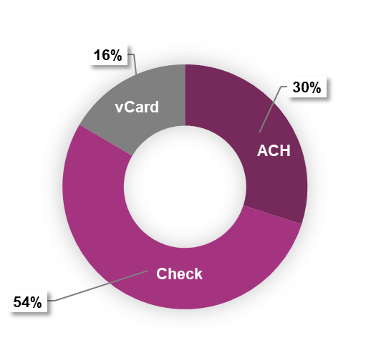
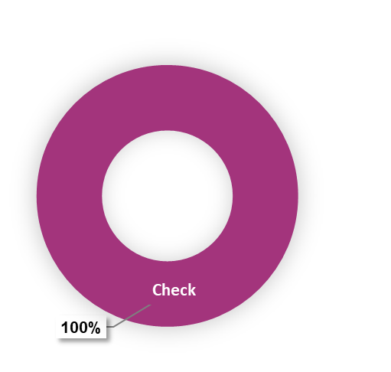
RETURN ON INVESTMENT
Payment Types | Current Spend | Current Payments | Projected Spend | Projected Payments
ACH | $ - | - | $ 14,016,418 | 1,385
Check | $ 32,204,625 | 4,628 | $ 15,683,159 | 2,478
vCard | $ - | - | $ 2,505,048 | 765
Total | $ 32,204,625 | 4,628 | $ 32,204,625 | 4,628
Current Payments
Projected Payments with
Integrated Payables
Client Annual Benefit Estimate: $90,000
Earn interest on excess liquidity
Rebate on Virtual Spend
Time savings
Fee savings

