Slide 1
The Equipment Finance Industry
What you need to know:
A high-level review of how and why companies finance their capital equipment needs
Jim Cochrane
Global Leasing
Commercial Equipment Finance
September 19, 2025

Slide 2
Notice to recipient
“Bank of America” is the marketing name used by certain Global Banking and Global Markets businesses of Bank of America Corporation. Lending, leasing, equipment finance and other commercial banking activities, and trading in certain financial instruments are performed globally by banking affiliates of Bank of America Corporation, including Bank of America, N.A., Member FDIC.
The following materials are for discussion purposes only and are subject to the recipient’s review and the recipient’s own assessment from a legal, tax, compliance, accounting policy and risk perspective, as appropriate. Bank of America, N.A. (itself or through or on behalf of its affiliates and subsidiaries) has not provided nor will it provide tax, legal, or accounting advice and will not be responsible or liable for any damages, consequential or otherwise, that may be incurred or alleged by any person or entity as a result of these materials or any transaction entered into in relation thereof. Recipient should consult with its own legal, tax and accounting advisors prior to entering any transaction. We assume no obligation to update or otherwise revise these materials. These materials have not been prepared with a view toward public disclosure under applicable securities laws or otherwise, are intended for the benefit and use of recipient only, and may not be reproduced, disseminated, quoted or referred to, in whole or in part, without our prior written consent. These materials may not reflect information known to other professionals in other business areas of Bank of America Corporation and its affiliates. © 2025 Bank of America Corporation. All rights reserved. 8343308 8.25

Slide 3
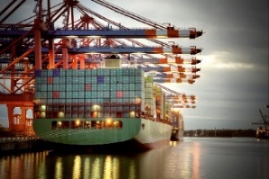
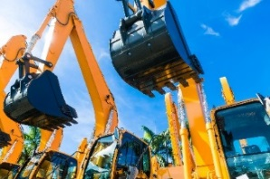

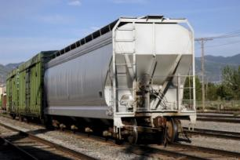
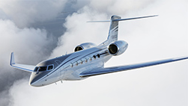
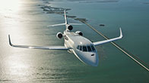
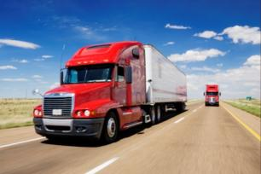

Overview of the equipment financing market
Equipment financing market expects continued growth
Investment by U.S. businesses in equipment and software is forecast to be more than $2 trillion in 2025, with 57% of that activity expected to be financed¹
U.S.
Nearly 8 in 10 U.S. businesses use some form of financing when acquiring equipment¹
Europe
In the European leasing market, the outstanding portfolio grew by 3.5% year-over-year in the first three quarters of 2024²
UK
Through the first 11 months of 2024, asset finance new business volume in the UK was 3% higher than the same period in 2023³
Asia Pacific
Future industry development will come from improved regulation and government support, and stronger demand for leasing driven by industrial upgrades of products and technology⁴
China
The financial leasing industry has leveled off from early high growth; steady growth is expected through 2026 as unified oversight of the industry is implemented⁴
Equipment acquisition trends¹
Equipment and software investment growth of 4.7% is predicted in 2025 as reduced borrowing costs boost demand.
Equipment finance will play a key role in enabling reshoring of manufacturing and improving supply chain resilience.
Equipment finance companies will increasingly adopt artificial intelligence to assess risks and optimize customer experiences.
The growing focus on sustainability will drive demand for financing solutions that support energy-efficient equipment, renewable energy projects and advancements in transportation technologies.
As internet-connected equipment becomes more prevalent, equipment finance providers will emphasize cybersecurity measures to protect customer data and assets.
¹Equipment Leasing & Finance Association 2025; ²Leaseurope 2025; ³Finance & Leasing Association 2025; ⁴China Financial Leasing Industry Report 2020-2026
Aircraft image trademark of Dassault Falcon Jet Corp.

Slide 4

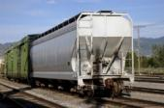
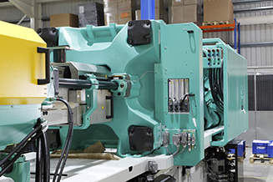
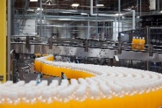


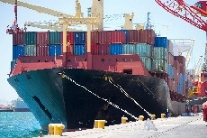
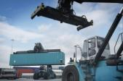
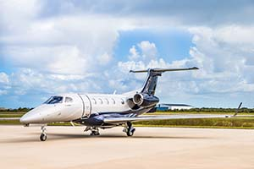

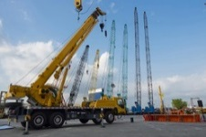
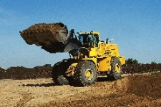
Common equipment sectors
Commercial Equipment Finance provides financing solutions for a wide range of collateralized assets and equipment
  Transportation
  General industries
  Office and Technology
Buses: school, charter and municipal
Corporate and maintenance fleets
Heavy truck dealerships
Rail: passenger, wagons/freight, locomotives
Vehicles: tractors, trailers, medium/light duty and specialty, electric and green
Beverage bottling equipment
Fabrication machinery
Food processing equipment
Grinders
Heating equipment
Machine tools
Manufacturing equipment
Material handling equipment
Packaging equipment
Plastic molding equipment
Power generating equipment
Printing
  Production line systems
  Recycling machinery
  Refrigeration equipment
  Restaurant equipment
  Robotics systems
  Solar projects
  Textile manufacturing equipment
  Utility meter and readers
  Water treatment
  Audio visual equipment
  Communications
  Computers and laptops
Data centers/server farms
Laboratory and test equipment
Office equipment and furniture
Security equipment
Software
  Storage devices
  Marine
  Aircraft
  Heavy equipment
  Articulated tugs and barges
  Container handling equipment and chassis
  Shipping containers/intermodal
  Specialty barges/heavy lift/dredging/pipe laying
Mid to large sized corporate jets
Turboprops, helicopters
  Agriculture equipment
  Construction equipment (road building, commercial, cranes, etc.)
  Heavy equipment dealerships/rental
  Mining equipment
  Oil Field Services, drilling and E&P assets
Aircraft images trademark of Embraer S.A.

Slide 5
Strategic capital formation
 | SHORT TERM CAPITAL (1-2 YRS) | MEDIUM TERM CAPITAL (3-10 YRS) | LONG TERM CAPITAL (+10 YRS)
 | Operational needs | Investment opportunities | Long range strategy
TYPICAL PRODUCTS | Revolving lines of credit Working capital | Loans and notes Tax-exempt or taxable, fully amortizing loans Equipment financing - loans and leases Sale-leasebacks | Mortgages
STRATEGIC OBJECTIVE | Address cash flow and capital gaps in normal operating cycle | Providing liquidity/cash during times of uncertainty Monetizing assets with a 3-10 year life Leverage current rate environment to generate revenue | Strategic capital formation to support long range plans for growth and market positioning
PRODUCT OBJECTIVE | Match funding of short term assets (A/R, A/P, etc) with short term capital | Monetize recently acquired 3-10 year assets Match fund medium-term assets with medium-term taxable and/or tax exempt capital Funding for new capital projects and ventures | Match fund long-term assets/investments (infrastructure/new markets) with long-term capital Funding for new investments Refinancing existing debt

Slide 6
Match equipment with appropriate financing structure
 | Equipment Finance | Traditional Bank Loan
Advance Rate | 100% for equipment bought within the past 12 months, including up to 20% for soft costs (installation, taxes, delivery, etc..) | Typically 80%
Collateral | Specific to the financed equipment | Blanket lien
Tenor | Up to 84 months | Typically 60 months
Index | Fixed Rate: Swaps of SOFR | Floating Rate: Term SOFR and Daily SOFR
Legal Fees | None | Outside Legal Counsel
6

Slide 7
Matching needs with solutions
Offering a broad range of options for capital raising and equipment financing
CAPITAL RAISING
TAX MANAGEMENT
  100% financing
  Access additional sources of funding (ability to tap into a different pool of investors, for example, non-bank investors)
  Possible Net Present Value (NPV) benefit by leasing
  Allocate tax benefits to the most tax-efficient party, minimizing the lessee’s after-tax cost of financing
  Manage an “inefficient” tax position, i.e. Net Operating Loss (NOL) or tax loss carry forward position
  Expedite emergence from Alternative Minimum Tax (AMT) position
Matching NEEDS WITH Solutions
EQUIPMENT RISK MANAGEMENT
BALANCE SHEET PRESENTATION
  Mitigate technological obsolescence and other equipment risk exposure
  Upgrade options
  Early buyout and other purchase options ensure lessee can regain ownership of the asset if desired and if economic
  Improve multiples and financial ratios, including leverage and Return on Assets (ROA)
  Enhance cash flow
  Obtain relief from financial covenant constraints
  Minimize balance sheet liability
7

Slide 8
Commercial Equipment Finance products
Lease Line of Credit | A lease line of credit similar to a bank line of credit which allows a Lessee to add equipment to a lease, as needed, under the same basic terms and conditions, without negotiating a new lease.
Finance Lease | A finance lease is a non-tax-oriented lease wherein the lease qualifies as a finance lease for the lessee for financial accounting purposes and is treated as a loan for tax purposes. Similar to a secured loan, this product provides the lessee with 100% financing in the form of a lease, while the lessee retains the risks and benefits of ownership. The lessee grants to the lessor a security interest in the equipment similar to a secured loan.
Tax Lease | A tax lease is a tax-oriented lease wherein the lessor retains the risk and rewards of ownership (depreciation allowances and residual upside and downside) and passes the benefits on to the lessee in the form of lower rental payments. A typical lease allows the lessee to purchase the equipment for FMV, renew the lease, or return the equipment to the lessor at the end of the lease term. Tax leases are typically structured as operating leases for the lessee from a financial accounting perspective.
TRAC Lease | A Terminal Rental Adjustment Clause (TRAC) lease is a tax-oriented lease specifically available to “over-the-road” vehicles wherein there is a rental adjustment at the end of the lease term. The amount of this adjustment depends on the actual value of the vehicle as compared with the originally estimated value of the vehicle upon which the lease payments were originally based. If the actual liquidated value of the vehicle at the end of the lease is less than the estimated value, the lessee is required to pay the deficiency to the lessor as the final rental. If the actual liquidated value is greater than the estimated value, the lessor will pay to the lessee the surplus, reducing the amount of the final lease payment. The lessor in a TRAC lease is the tax owner and is entitled to the depreciation allowances. The TRAC lease is typically a finance lease for the lessee for financial accounting purposes but may be structured as an operating lease.
Synthetic Lease | A synthetic lease is a non-tax-oriented lease that can be structured as either an operating or finance lease for the lessee for financial accounting purposes but is treated as a loan for tax purposes. Consequently, the lessee is the tax owner and retains the tax depreciation allowances along with the residual upside. The synthetic lease is typically structured with a purchase option in an amount equal to the projected fair market value of the equipment at the end of the lease term. If the purchase option is not exercised or the lease term renewed, the equipment is sold to a third party and the lessee provides a first loss residual value guarantee to the lessor. The synthetic lease can minimize the balance sheet impact for long economic life assets.
Secured Loan | A secured loan is a term debt instrument that is collateralized by a specific portfolio of equipment. The lender makes a loan to the borrower who agrees to re-pay the loan through making installment payments over an agreed upon term comprising of both interest and principal payments. The secured loan may be subject to financial covenants made by the borrower under the terms of the loan. The borrower remains the tax owner of the equipment and is also the owner for financial accounting purposes. The borrower grants to the lender a security interest in the portfolio of equipment.

Slide 9
Benefits of leasing

Slide 10
Cash flow accounting
Cash Flow Statement - Financial Accounting Standards state that the primary purpose of the cash flow statement is to provide information on the cash receipts and cash payments of an enterprise during a period.
    Investing Activities - Under ASC 230-10-50 (formerly FAS 95) the Investing Activities section includes information on the cash inflows and cash outflows during the period for activities such as capital expenditures for PP&E.
    Cash Expended - But this reporting includes only activity where cash is expended for assets acquired. Therefore the Investing Activities section and the Capital Expenditures line do not include amounts for assets acquired under finance leases where no cash is expended.
Finance leases - This presentation reflects the fact that the company does not actually pay out any cash for the assets obtained under finance leases, even though the finance lease assets do appear on the balance sheet.
    However, the amount of assets acquired through finance leases does need to be disclosed in the footnotes to the financial statements.
    Future lease payments are captured in the Financing Activities section of the cash flow statement as a reduction in debt or finance lease obligations.

Slide 11
Improve reporting metrics with a lease
Remove impact to reported CAPEX
$$Adjusted Free Cash Flow=Net Cash from Operations−CAPEX$$
A Lease is the ideal structure for companies who have substantial capital equipment requirements and manage to an Adjusted Free Cash Flow metric.
Leasing structures offer several advantages over direct cash expense or alternative forms of financing.
A Lease does not impact reported CAPEX, unlike traditional debt financing (i.e. loans, credit facilities, and bonds)
A Capital lease allows you to fully utilize the benefits of depreciation
An Operating lease provides favorable balance sheet treatment, and in some cases, can have a rental expense that produces a lower impact on earnings than depreciation
Additional benefits of a Lease Structure:
Low or no up front fees
No external legal or documentation fees
Document light schedule structure
Frees up capital that can be deployed towards
Higher yielding investments
  Build or retain liquidity position
  Utilize freed cash to create shareholder value
      Share Buy-back
      Dividends
      Acquisitions
The below example illustrates the effect on Operating Free Cash Flow by moving to a Finance lease
Results from purchasing equipment with cash
 | 2020 | 2019 | 2018
Cash Flow from Operations | 244 | 176 | 145
CAPEX | -131 | -121 | -95
Operating Free Cash Flow¹ | 113 | 55 | 50
Results if 50% of equipment purchases were financed through Capital leases
 | 2020 | 2019 | 2018
Cash Flow from Operations² | 244 | 176 | 145
CAPEX | -65.5 | -60.5 | -47.5
Operating Free Cash Flow¹ | 178.5 | 115.5 | 97.5
¹Adjusted Free Cash Flow = Cash from Operations less CAPEX; ²This will change from the other scenario based on the difference in the interest expense from the lease vs the existing forms of financing. Interest expense could be slightly lower or higher, depending on the rate. This scenario holds the interest expense the same for the sake of simplicity.
11

Slide 12
Accounting treatment of leases
ASC 842 accounting overview
Summary
Under Accounting Standards Codification (ASC) 842 lease accounting, lessees must capitalize all leases with a term greater than 12 months onto the balance sheet at the present value (PV) of all outstanding lease payments Including residual value guarantees to the extent of the ‘amount probable of being owed’ The lease liability is typically calculated using the lessee’s Incremental Borrowing Rate Liability is presented on the balance sheet separate from debt Leases are classified as operating or finance leases using classification tests Operating leases have level expensing of rents over the term of the lease Rent expense is an operating expense and may reduce EBITDA Finance leases have a front-loaded expense profile of interest and depreciation expense The balance sheet determination is separate from the lease classification and the lease expense recognition Residual value guarantees are recognized on the balance only to the extent of the ‘amount probable of being owed’ Cash flow accounting for operating and finance leases does not report leases in CapEx where the lease is fully funded by the lessor and there is no sale leaseback
Bank of America has not provided nor will it provide tax, legal, or accounting advice and will not be responsible or liable for any damages, consequential or otherwise, that may be incurred or alleged by any person or entity as a result of this document

Slide 13
Accounting Treatment of Leases
ASC 842 Lessee Accounting - Operating Lease Illustration
Accounting Example- Railcar Lease
$100MM Lease, 10-year term
$38MM residual value, $8.4MM annual payments
Balance Sheet Accounting - Operating Lease Db Cr
Right-of-Use Asset $70.7 MM
Lease Liability $70.7MM
Lease is capitalized at the PV of the rent payments
Income Statement Accounting - Operating Lease Db Cr
Rent Expense $8.4MM
Cash $8.4MM
Operating lease expense is recognized for the amount of the rent payments
Cash Flow Statement Accounting - Operating Lease
Rent Expense reduces Net Income and Cash Flow $8.4MM
Capital Expenditures $0MM
As long as the lessor fully funds the asset and there is no sale leaseback, the lessee does not report any CapEx for the lease of the assets
Bank of America has not provided nor will it provide tax, legal, or accounting advice and will not be responsible or liable for any damages, consequential or otherwise, that may be incurred or alleged by any person or entity as a result of this document

