Slide 1
The Financial Close Process is a Journey: Own It

Slide 2
CPE Credits
Today’s webinar is worth 1 Continuing Professional Education (CPE) credit.
*Please be sure to enable your media player to hear audio*
To be eligible for CPE credit, you must:
Answer at least 3 of the 4 polling questions (during the webinar)
and have a total viewing time of at least 50 minutes.
Participants will have the opportunity to download their CPE certificate immediately following the webinar if above requirements are met.
In accordance with the standards for the National Registry of CPE
Sponsors, CPE credit will be granted based on a 50-minute hour.
We are unable to grant CPE credit in cases where technical difficulties preclude eligibility. CPE Program Sponsorship guidelines prohibit us from issuing credit to those not verified by the technology to have satisfied the minimum requirements listed above.
FEI provides professional development solutions for financial executives that take your learning path to the next level, with continuing professional education credit opportunities through webinars, in-person courses and conferences, as well as on demand learning.
▪ Learn more about upcoming coming opportunities and registration online at www.financial executives.org/events. ▪

Slide 3
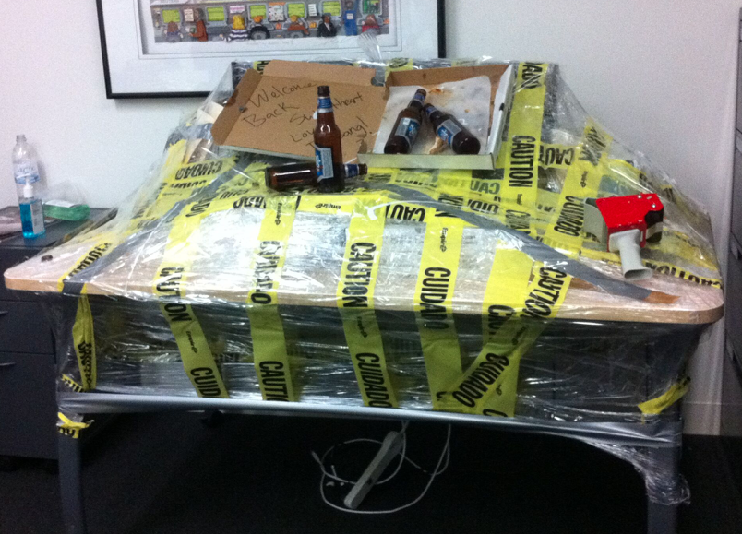
Steve decided to take some time off during month end close. The rest of the accounting team had to cover for him and this is how they thanked him. Don’t be like Steve… unless you have a simplified month end close.
Notes:
Let’s begin with a story – the names have been changed to protect the innocent… and guilty, but the story is real. Years ago I worked in an organization with $100M in revenue and I sat with and was friends with the controller, accountants, and the broader financial team. I remember when I was new to the job and the first month end close was upon us and I started to hear about “the sheet!” Much to my surprise, although probably not a big surprise to all of you, this company, with $100M+ in revenue, was using excel to do everything! It took a team 5 or 6 people, working late nights and weekends, to get the books closed by the 10th of the month, which was the target set by the CFO. I always felt bad for them… but not as bad as I felt for Steve. During one of the close periods he decided to take a vacation, but the team still needed to close by the 10th! So the team worked extra hard, and to blow to off steam created a lot of “I hate Steve” memes. After they finally finished they blew off steam by going to town on Steve’s desk, of which this is an actual photo. When he got back he couldn’t understand why! So please, don’t be like Steve….unless you have a simplified close process!

Slide 4
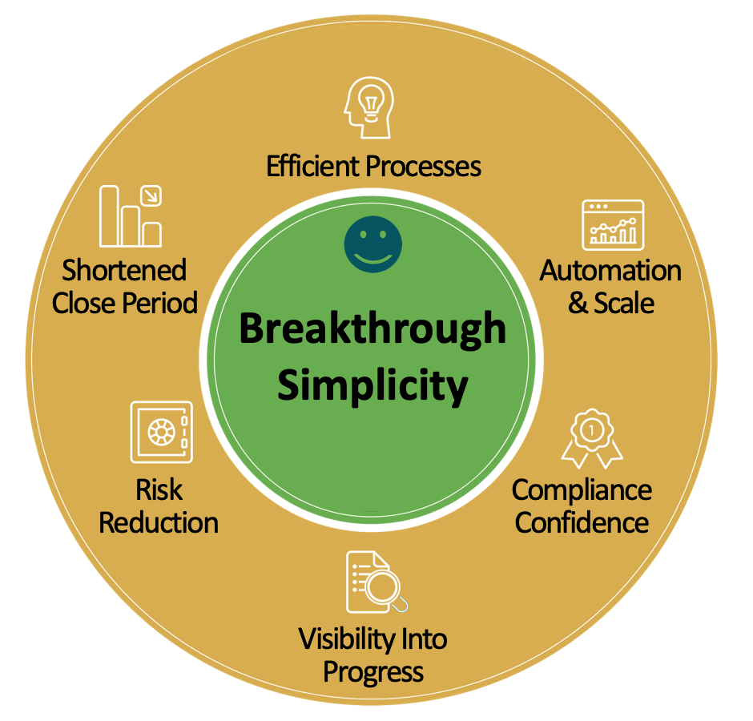
What are we trying to achieve?
Notes:
And that’s why we’re here to today, to talk about breakthrough simplicity in the financial close process! It is a critical financial task that needs to be accurate, but it doesn’t need to be manual and it doesn’t need to take a tremendous amount of time to complete. For the next 45 minutes we’re going to take you down a path to simplifying and modernizing your close process, so you can stop stressing at the end of every financial period and instead focus on the tasks you enjoy doing.
And when we’re done, you’ll see how owning the close process journey will help you get more efficient, introduce automation and scale, make you confident you’re compliance and ready for an audit, give you visibility into progress in the month but also visibility into the processes, help you reduce risk and be confident in your numbers, and the ultimate goal – shortening your close period.

Slide 5
Factors that impact the need to improve the close process…
Notes:
As you take ownership of the close journey and simplify and automate it, it’s very important to understand why. The CFO could be saying we need to cut close times, but what are the benefits it brings to the organization? To you as a team? Understanding this helps you see the impact finance has across the organization and can be very motivational.

Slide 6
CHANGING LABOR FORCE
Notes:
Over the past decade the changes in the demography of the workforce have become more pronounced, many of us have seen this within our own organizations as the tenured personnel move on and new people are brought into effectively perform the same work.
In fact, in 2016, the average "Baby Boomer" turned 60 years old… as such, the departure of this massive labor cohort is now accelerating at a rate which is placing tremendous strain on businesses. In fact, commonly accepted statistics cited by the US Social Security Administration and Pew Research indicate that a stunning 10,000 Baby Boomers retire every day in the United States. I would suggest these statistics would be relative across most modern economies. Hard to believe.
2017 also represented the first time that the Millennial generation surpassed both the Baby Boomer and Gen X in terms of the number of people in the workforce.
It’s no secret that the “Millennial” generation is very different than any other generation coming into the workforce. Technology was “born” into this generation versus “learned”. At the risk of dating myself, when I first studied accounting, I learned on the familiar columnar paper, only to abandon that for Microsoft Excel and now purpose-built systems. The point that I am making is that the new labor pool has a level of comfort with technology that many in the past did not have. To make it more interesting they also have a very different view of the employee-employer relationship.
A May 2016 Gallup Poll survey indicated that 60% of all millennials are open to a new job. This same poll indicated that almost 25% of millennials had changed jobs within the prior year, a rate that is three times higher than the number of non-millennials reporting the same. It is evident that business' can expect and should prepare for a more fluid labor pool going forward as millennials view the relationship with their employer to be more transactional in nature.
Acknowledging the aforementioned changes in the labor pool and the very different way that the emerging working-age employees tend to view their participation in their careers, business' in general are hugely exposed to degradation of their institutional knowledge (IP). In earlier years, Finance and Accounting (F&A) professionals relied heavily on manual processes and office automation tools, including the ubiquitous Microsoft Excel, to perform their critical period-end activities. As mentioned previously, logic dictates that such a process relies heavily upon the experience and institutional knowledge of accountants, but how can an enterprise be expected to ensure that this process works smoothly and without error when the wizened "elder-statesman" just retired and the new, energetic go-getter does not seem compelled to fully engage?
In general, the capture and retention of Institutional Knowledge is now a consuming passion for forward-thinking leaders. However, I would argue that we must look beyond simply recording the past. We ought to consider how we might capture this knowledge in a framework which would allow us to encode the very best of our core F&A knowledge and carry it forward.

Slide 7
PRESSURE TO FURTHER REDUCE COST
Notes:
Moving on to the second converging meta-trend: the unrelenting…“Pressure to further reduce cost.” Of course, this is trite and cliché, when does management not have a pressure to reduce cost after all. But, this time is a little different.
In the early-mid 2000’s enterprises engaged in a virtual "land rush" to migrate cost-intensive, back office operations to offshore/outsourced providers in order to take advantage of lower cost labor. Finance and Accounting was at the top of this list. Many organizations did this with an eye towards lower cost and a desire to capture this "labor arbitrage" as rapidly as possible. In order to capture this windfall many enterprises simply lifted and shifted their current onshore business processes to these remote delivery models. Predictably, the result in many cases was a lower labor expense, but an offset increase in errors and re-processing which mitigated the overall value.
In fact, in Deloitte’s 2017 Global Outsourcing and Insourcing Survey, they cited “…a small but growing reversal, where companies that have previously offshored functions are bringing them back.” The survey pointed to, “issues around quality of work as well the inability to achieve cost targets as the primary drivers.” Taken in totality and viewed against the background of increased regulatory risk and data security concerns, many organizations have begun to question the premise of offshoring/outsourcing.
So, how do we improve the overall timeliness and quality of the end deliverable without increasing our labor cost? The labor windfall having been had, a return to the previous status-quo is not possible…. We are not going to find people in Silicon Valley, New York or Orlando who are going to be willing to work for the same salary as those in Chennai, Krakow or Manilla. This is quite a puzzle.
Given that there is an indicative trend toward diminishing returns for human-centric resources, the next logical inflection point would be to replicate our best and brightest within a scalable technology framework, one which would lend itself to continuous improvement and unbounded scale.
Consider this.. General Accounting activities, such as daily and period-end reconciliation, journal entry preparation and close management exhibit somewhat predictable, rule-driven tendencies. This means that a technology solution is a profound possibility. But before we draw this bright-line, we should address another challenge - that of scale.
Whether scale is achieved through organic growth or through acquisition, the push to grow revenue is as constant and unrelenting. Herein lies the challenge for most companies and…the fastest way to scale is to hire people…it is also the most expensive over time.
In addition, as the business cycle matures, the unfortunate necessity is that this cost becomes a concern, and Finance and Accounting are a clear cost center, targeted early and often for cost reduction. So, it goes...businesses inflate labor as the business cycle accelerates and then purge as a cost control measure in order to maintain margins during periods of recession. But, as we know the work itself never goes away, those that remain still need to be able to close the books with certainty and on time. This process repeats itself over and over again through the business cycle.
Therefore, in order to achieve scale without having to increase cost, many companies are now turning to the same sort of reflective analysis that they used to assess the viability of moving labor to an offshore/outsourced model in the first place. However, in this instance rather than replacing the onshore labor with a similarly skilled worker in a remote location, business is turning to Robotic Process Automation (RPA). Succinctly put, RPA represents the opportunity to encode within a technology framework, the attributes of our very best Finance and Accounting professionals without dependence on the human. Further, RPA processes never “call in sick”, decide to look for greener pastures or must be “let go” in order to control cost.
Sounds promising… but how to do it.

Slide 8
INTERNAL NEEDS
Notes:
Personally, for me, as a consumer of finance reports – especially numbers like churn, expansion sales, and other customer driven metrics – it’s important for me to get data quickly. The same is true for other executives and the broader leadership team. They need to get the real numbers as quickly as possible so they understand performance and can prepare for leadership meetings.
But speed alone isn’t important as the data also needs to be accurate. What good are numbers if you don’t believe them. You can’t use them to strategize, they can’t be reported out to the board, they simply provide no value. Forgetting speed and simplification for a minute, in a survey EY ran 1,000 CFOs across 25 countries in organizations with revenue greater than US$500m, CFOs’ confidence across all aspects of corporate reporting ’ they learned “Almost half of CFOs are not even confident/somewhat confident in their financial compliance” .. That’s scary considering these numbers are so important to an organization. So as we talk about simplifying and improving the close process, we also mean improving reliability.
Another important factor that is sometimes overlooked, but the story I just told helps illustrate, is employee satisfaction. The team was miserable every close period as they had to work long days and weekends. This leads to burnout and turnover, which no one wants.
These are some examples, but we’d love to hear from you – take a moment to use the ask a feature function in (webex? Gtm? And tell us why you want, or need, to improve your close process.

Slide 9
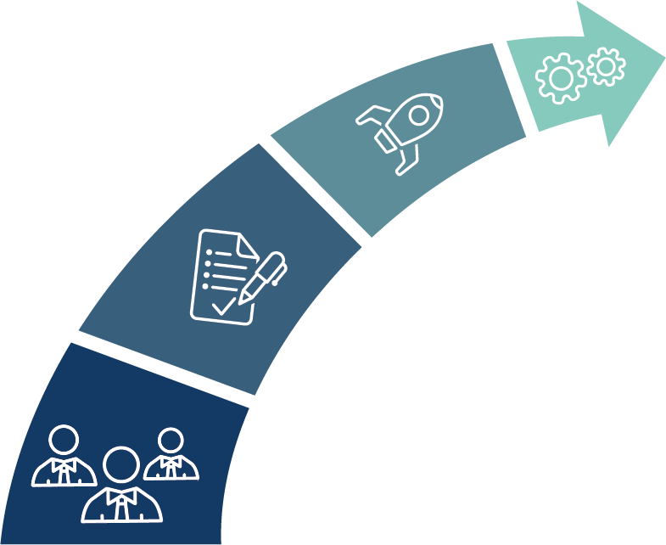
The Simplification Journey
Automation
Optimization
Standardization
Decentralization
Less Manual and More Modernized: Lowered Risk, Increased Efficiency and Simplified
Notes:
This is what we view as the journey to simplification. It’s not an uncommon journey, and is one I’ve seen across organizations in different departments. That said it is important to understand it and own it. This way you can move from one stage to the next, and in doing so simplify your processes and life during every period end close – then you can be like Steve and take vacation!
More importantly though, by moving down this path, it provides several major benefits:
First off you can start to meet the factors we spoke about before – changing labor force, pressure to reduce cost, and internal needs.
It also gives the finance team more time to focus on other initiatives, such as ad hoc needs, improving compliance and controls, identifying and preventing potential fraud, internal team development, and so on
You also have more time to identify other opportunities to help out across the organization, such as creating department level P&Ls, create non-gaap reporting that is easier for the rest of the business to interpret, and more
You’ll also have a much happier team as they’re less stressed during the close period and they’re able to broaden what they do
As a finance organization you’re now having a greater impact on the company and getting more done.
So what are these steps? To illustrate it, I can share a common pattern I’ve seen at several start-up companies I’ve worked for. In the beginning, as they focus on the product and sales, finance is usually an afterthought and is fully outsourced to a “CFO for hire” type firm. This works well in the early stages as your company is growing an expanding, however at some point you need to bring the finance function in house, so you typically hire a CFO or VP of Finance. Then they usually bring in a controller or accountant to take on some of the work. And as the company continues to grow they hire someone else. Before you know it you have a team of awesome performers who each own their piece of the close, and other, finance processes. This model is very decentralized though as each person is responsible for their own piece of the pie.

Slide 10
Decentralization
Everyone has their own process using Excel, Binders, and Highlighters
Lack of transparency into processes and controls
Lengthy Close Periods
Little to no time for value added tasks
Not scalable
Bottlenecks and dependencies
Low trust in the financial statements
Millions of companies are currently completing their close process in many excel files maintained by the staff, a physical binder for sign-off, or no process at all.
Notes:
This decentralized model, while effective at first, begins to break down over time.
First off, there is a problem of tribalism, where everyone knows their own stuff, but it’s not documented or clearly shared, so what happens when someone leaves? At a company I worked for, the primary finance person left, so suddenly expense reporting broke, commission payout got delayed, and several other mission critical problems surfaced. It took us many months to fully recover from the impact.
Additionally though, there are other challenges:
Lack of Transparency into process and control. This is related to the tribal knowledge problem, but it also means as a manager of a group, you have little insight into just what is happening, so it makes it hard to predict, challenging to analyze and improve, and difficult to coach and improve the team.
Lengthy close periods are not uncommon – in fact I’ve talked with customers and prospects who have said their close process takes most, or all, of the month, so they’re literally constantly in a close period!
Little to no time for value add tasks – this includes some of what I just mentioned- ad hoc reporting, controls and fraud prevention, and so on. It goes without saying that if your close process is very lengthy, you have little to no time for much else
There is no scalability at all. As we just talked about, if someone leaves, you’re in trouble. At the same time, if business grows by 50%, and someone is now overwhelmed in their processes, you have no choice but to hire someone else, and now you struggle finding time to train them.
Your processes are probably riddled with bottlenecks and dependencies, but you have no ides how many or what they are.
How many times have you created a report, sent it out, only to have someone question the results, or worse find an issue? Without a standardized approach or systems in place, mistakes happen, so the data is often questioned and many times not fully reliable.
So step one to resolving this is to move to the next step of the journey – standardizations.

Slide 11
Standardization
Adding structure, organization, and centralization behind the manual process
Basic visibility into processes and controls
Better able to measure and shorten close periods
Minimal amount of time for value added tasks
Can start to scale
Bottlenecks and dependencies identified
More trust in the financial statements
As companies mature and grow, the standardization of processes will become necessary to scale without adding staff at the same capacity.
Notes:
To continue the story, once a company has several people on the finance team and they’re realizing a decentralized model has some challenges they need to get around, the very first thing they do is start to standardize. While you’d like to jump right to an optimized process or even automated one, you can’t skip over this step – or how do you know what and where to optimize? Or what happens if you spend the time and money to automate bad processes you later learn you need to fix?
As we talk about standardizing, we mean ensuring everyone uses the same systems, documents their processes in a centralized location, adopt the same process and procedures if performing similar functions, purchasing new software, such as a task management application to get everything organized and so on. You’re now moving into a model where it’s possible to understand who does what and the outputs seamlessly work together.
Let’s walk through the same factors we looked at in the decentralized approach:
First, now that you’ve developed standards, have it recorded in a centralized location, and ideally have everyone reporting progress in a standardized application – again possibly something like a task management tool, you now have some basic visibility into processes and controls. What do we mean basic? Well you know what the controls are, you know what the processes are, and you have status reports so you can get some kind of idea of progress during the close process.
With this basic visibility and standardization, you can actually start to shorten close process. As a manager of a finance team you can get a better understanding of who does what and take the status reports to shuffle and move tasks around during the close to ensure they’re done quicker.
While in a decentralized model we said you have almost no time for other value add tasks, because you’re able to shorten the close period a little, hopefully this gives you more time to focus on other things, again such as controls, fraud prevention, and so on.
At this point because you’ve standardized and documented everything, you can start to do things with a little scale. For example, as I just mentioned, you can shuffle tasks around if you know one person is
Bottlenecks and dependencies still exist, but because the processes you’ve used are standardized and documented, you can at least identify them and start planning around them.
At this point, while trust in the data might still be low, it’s definitely better than in a decentralized manner as you know who is doing what, where to go if you have a questions, and everyone is using the same applications.
While it’s great to standardize everything and document processes, if you’re like me, now you want to optimize it!

Slide 12
Optimization
Optimizing the standardized process to gain additional benefits and control
Higher visibility into processes and controls
Processes simplified and close periods shortened
More time for additional value add tasks
Easier to scale
Bottlenecks removed and dependencies planned for
More trust in the financial statements
Once internal processes are standardized and everyone is on the same page, you can now start creating more efficient flows of data in an organized fashion.
Notes:
Ok so now we’re at a company that has several people in their finance team, maybe it’s grown to 5 or 6 now. They’ve standardized everything, documented it, and hopefully track everything in a single application so they’re able to report and track progress. But it doesn’t stop there! As this company continues to grow, it becomes imperative to optimize your processes. If you don’t do this not only will you be unable to scale effectively, you’ll continue to struggle at close and you’ll always have a lack of trust in the data produced. So now it’s time to optimize! As for what we mean by optimize, it’s a couple things.
First off now that you understand everyone’s processes and how they spend their time, you can make sure you have the right people completing the right tasks. You can re-order steps and processes to ensure you’re doing things in the right order. You can also know what activities you should start right as the month end as opposed to others you can start later . Basically you can begin making process improvements to increase efficiency and get things done faster.
At the same time, you can adopt software to optimize your processes. For example if you still use excel for your account reconciliation process, you could use some software that helps track it all, makes it easier, and integrates right with your GL. By both attacking your processes and adopting new applications, you can begin to see real gains. Lets look at the same factors we’ve been using:
First off you now have high visibility into your controls and processes. Not only do you know who is doing what, the order of operations, and other benefits gained during standardization, by adopting new tools and applications you can get real time status reporting during the close period, have records of who completed what for further analysis and auditing, and you’ve taken full ownership of the entire process by analyzing and optimizing it.
This is also when you start to see real gains in the close period. By improving flows and again adopting new software, you can shave a lot of time off your close periods.
And because the close period has been greatly shortened, you finally have time to start working on other tasks and providing additional benefits throughout the organization.
It probably goes without saying, but as you optimize and improve processes, you’ll also be able to remove bottlenecks you’ve identified. You may not be able to remove dependencies, but they can be fully planned for and you can make sure they’re completed in the right order and in a timely fashion.
Finally, as your team is able to short the close process, they have more time to validate data and reports and make sure you’re able to really trust the output. Plus, as you now have clear audit trails and logs of who did what, if you run into an error, it’s easy to identify what happened and fix it so future reports don’t have the same problems. Identify where risks are by looking at potential write offs and adjustments. And by seeing this in real time it enables you to fix it this period.
At this point you’re running a pretty efficient ship, but there is one more step to seeing true simplicity… automation!

Slide 13
Automation
Completely automate low risk tasks and simplify the entire close process
High visibility into processes and controls
Close process greatly simplified and shortened
Lots of time for additional value add tasks
Simple to scale
Bottlenecks removed and some dependencies automated
High trust in the financial statements
After standardizing and optimizing your current processes, automation will create real efficiency gains by taking low risk tasks off your plate to focus on more value-added tasks.
Notes:
In the close process, when we talk about automation, it’s really the bank to book reconciliation process and a little account reconciliation. Imagine a world where at a click of a button 60, 70, or even 80+ % of your bank and GL accounts are reconciled! How much time would you save from that alone? Also, if your accounts with no changes auto certify and those with assets that should carry forward do so automatically, and any account you have certified sees a change and you’re auto notified… now we’re talking true simplification. You’re no longer spending time on tasks that a computer can just do for you. On top that, you’re removing human error from the equation! This is the holy grail of period end close simplification. How much happier would this make you? How would moral on the entire finance team be improved if they’re no longer working weekend and long nights at the beginning of every month?
To get here you will need software, but the ROI is massive, and again let’s look at the same categories we’ve used throughout this journey:
At this point you’ll have high visibility into processes as you’ve automated them. If you’re using the right application, it will report back results from automation so you’ll know what matched and didn’t, what is automated and what isn’t and so on. You should also have dashboards and reports showing every step of the close process, who owns what, outstanding activities and so on.
As we just talked about above, you’ll have automated some of the most time consuming tasks, so your close process is now very simple and very fast.
And with this shortened close process you now have time to spend on a variety of other activities.
You’re also running very lean at this point, and your most time consuming tasks are automated, so you can really work at scale! One important thing to note as a lot of people seem to think this puts their job at risk, but that is not the case! Just because you’re very efficient and lean in your close process doesn’t mean you don’t still play a pivotal role in another activity – such as team development, analytics, working on budgets, or non-gaap business reporting, and so on. You an everyone else on the finance team can be adding value in many way across the organization!
Bottlenecks were mostly removed during optimization, but with automation you remove any outstanding ones – such as a majority of bank to book reconciliation! Dependencies can also be automated.
And finally, you can really trust the output. Why? Because of two main reasons:
1) You’ve removed human error from some of the mundane activities that are most susceptible to human error
2) As you’ve automated a lot of activity, and simplified a lot of the processes, you and your team now have time to spend on the more complex and very high risk close processes that were identified as you moved thru optimization. There is no need to rush.
So at the end of the day you can feel confident in the results.
At this point you’ve completed the journey, but your job isn’t done! You’ll want to continue to optimize processes making it possible to automate more! As your business grows you might add more bank accounts you’ll want to work into the automation. So it’s important to keep improving.

Slide 14
Where Are You In Your Journey?
Automation
Optimization
Standardization
Decentralization
Less Manual and More Modernized: Lowered Risk, Increased Efficiency and Simplified
Notes:
So, where are on your journey? It’s important to take stock and realize where you are so you can start planning the next steps to move down this path. And remember, you don’t want to skip ahead! You don’t want to automate bad tasks, or try to optimize without first understanding and standardizing processes.
Also, it’s very important to note that with the right partner, this entire journey, from decentralized to optimized, can happen very fast. I’ve seen it completed in as fast as a few weeks if you dedicate time and resources to getting it done. It doesn’t take complex software or tools to get there.

Slide 15
Notes:
One final comment on the journey, and owning it, is implementing processes, improvements, and software to get you to the ideal state of a simplified close process. As I alluded to a few minutes ago, It shouldn’t take you a quarter, or 6 months, or more. If you purchase an application or hire a consultant, and they tell you it’s going to take many hours of consulting or setup work over the next 6 months, then something is amiss. The close process, while different at every company, isn’t so different that you can’t adopt best practices and new software quickly. There are a few core parts to focus on that have maximum impact:
1) Bank to book reconciliation – which when it comes down to it, is really just codifying how you match your general ledger to lines in a bank statement. You have these processes today as you already close your books, so now you just need to move that into software
2) Account reconciliation – while you may have a lot of accounts to reconcile, once you get an automated import going to a software application, and you automate your matching rules as we just talked about, then it’s really a matter of focusing on exceptions and accounts that changed in the last month. So really the only work is the import, and that shouldn’t be hard to get going
3) Process improvements – with the right partner, you can learn best practices to improve how you close the books, and if you do adopt automation software, making some simple process changes will improve automation effectiveness and make it easier to reconcile accounts. But it’s not rocket science here but instead it could be depositing checks faster, or including some additional information in a journal entry, and so on. Simple changes have a huge impact.
As you can see, with a little dedicated time over a few weeks, you should see significant ROI. That’s way better than spending 6 months trying to improve how you close and having your team distracted by that and struggling to get everything done. So finding the right partner is critical, and with that, let me hand things over to Jonathan White to talk amore about it.

Slide 16
Financial Software Partners
Notes:
Brian gave a great overview of the 4 stages of the financial close process. I am going to spend time talking to you about how you can leverage a financial software partner to assist with your close process journey. Any investment you make to improve the close process is pivotal to the finance org and can’t be taken lightly. I would encourage you to strongly consider using a financial partner vs buying a solution from a company. The latter can put you in the wrong paradigm and prevent you from seeing the forest from the trees.

Slide 17
You don’t need to be a Superhero; you need a Partner…
Reduce workload
Optimize resources
Improve work life balance
Drive transformational change
Notes:
#3 reference study about how
#4 the new norm is for finance orgs to be less about producing reports and more about building strategies aligned to your company’s growth.

Slide 18
Questions to ask…
Do they deliver consumable and flexible training options?
Do they leverage a community-centric approach to help you standardize, optimize, and automate?
Do they drink their own champagne?
Do they leverage online review forums?
Notes:
#1 you have found a partner with a good solution and price point, but how quickly can they get your team implemented? What is their process to keep you updated? Is there a single communication platform
#2 is the prospective partner actively leveraging its customer base to drive communications, learnings, best practices. As a customer, this is a great way to stay connected with peers leveraging the same solution(s) as you.
#4 what are customers saying about the partner. Are they leveraging online reviews? Don’t be afraid to ask for customer references.

Slide 19
Core Tenants of a Partnership…
Alignment
Agility
Win-Win
Notes:
These are the 3 core tenants of a partnership if any of them is missing the foundation is weak, and most likely the partnership will not be sustainable.

Slide 20
Alignment
Assess and understand challenges and the corresponding scope of work required to drive course correction
Achieve consensus on each party’s responsibilities to drive goals
Build the proper communications network and cadence
Notes:
#1 Discovery phase this is when the partner earns their keep, they can identify and assess challenges and build a course correction plan
#2 Both parties are responsible-active engagement helps to ensure alignment
#3 this goes back to my point of there being a single communication platform

Slide 21
Agility
Have expertise and bandwidth to meet current and future needs
Provide appropriate solution offerings
Understand your unique challenges
Notes:
#1 Can they meet you where you are with the ability to adapt as your or marketplace needs change
#2 Is the solution Cloud-based? Does it compliment your current set of tools? How well does it integrate with your current tool set? Do they have a one size fits all solution that will work for the same for a $50M company or a $5Billion dollar company?
#3Deliver they have right people (right skillet and expertise) to help achieve goals

Slide 22
Win-Win
Build clarity for financial close process
Create the blueprint for partnership
Achieve mutual goals
Notes:
#1 You have achieved complete clarity from a process, communication, and learning perspective.
#2 The clarity achieved will help provide the blueprint for the partnership’s success

Slide 23
Close Process Nirvana
Reduce Time Spent on Balance Sheet Reconciliations- up to 70%
Close Faster by 50%
Reduce write-offs up to 10%
Notes:
So, what does Nirvana Look like?
According to recent polling of CFO’s, Top financial software partners can reduce time spent on Balance Sheet Reconciliations by up to 70%. Top Financial Software Partners help customers close faster, the number of days is reduced in half. And they help to reduce write offs by up to 10%
Achieving Close Process Nirvana will help increase the quality, integrity and efficiency across your finance organization.

Slide 24
Learning Recap
Assess where you are in the financial close journey
Identify your challenges/needs
Select a financial software partner

Slide 26
Want to find the right Financial Software Partner?
Jonathan White
Jonathan.white@trintech.com
Brian Rogers
Brian.rogers@trintech.com
Why Adra?

