Slide 1
Josh Boone
Vice President Finance & CFO
February 19, 2018

Slide 2
Agenda
BIO & Career Overview
Company Overview
Major Markets
Capital Allocation Strategy & M&A

Slide 3
BIO

Slide 4


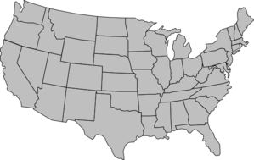
BIO
Education
  Bachelor of Business – Finance & Economics
  Eastern Kentucky University
  Master of Business Administration – Accounting
  University of Houston
Family
  Married (12 years)
  Three Daughters (7, 5, 2)
States Lived In
  Tennessee
  Illinois
  Indiana
  Oklahoma
  Texas
  Kentucky

Slide 5



Career Overview
2014 – Present
Chief Financial Officer
Director of Finance
2012 – 2014
Chief Financial Officer
2007 – 2012
Director of Finance
Corporate Manager of Financial Planning & Analysis
BBG Manager of Financial Planning & Analysis
Sr. Financial Analyst
2005 – 2007
Accounting Software Analyst
Accomplishments:
  Actively progressed through 4 roles at Brunswick Corp. in less than 6 years
  CFO of ~$100MM private company at age 33
  CFO of ~$1B public company at age 36

Slide 6
Company Overview

Slide 7

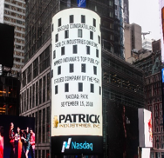


Patrick History
Common stock offering
Credit facility expansion to $450MM
Completed 3-for-2 common stock split
Credit facility expansion to $500MM
$170MM Convertible note offering
Company taken public (NASDAQ)
Completed 3-for-2
common stock split
Date of Incorporation
Todd Cleveland named President (‘08)
and CEO (‘09)
2018
2017
2015
2010 - 2017
2009
2008
1968
1961
Acquisition Highlights (2010-2017)
  44 companies
  $660MM aggregate purchase price
  $1,005MM annualized revenues
2007
1959
Acquired Adorn Holdings, Inc. – the largest acquisition in the Company’s history
Company founded

Slide 8
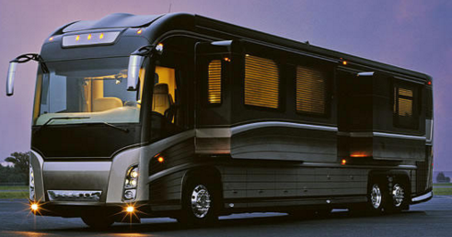
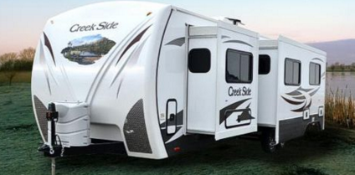
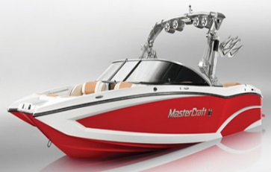
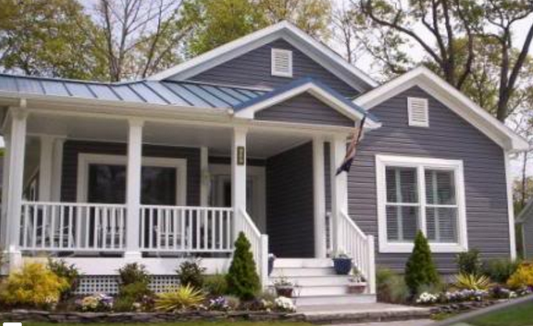
Patrick at a Glance
Our vision is centered around driving growth organically and through disciplined strategic acquisitions in all of our core market segments providing product expertise, differentiation, and optionality as well as expanding our customer centric geographic product footprint and reach
Facts
2017 Highlights
Founded in 1959 and incorporated in Indiana in 1961
Headquartered in Elkhart, Indiana – the “RV Capital of the World”
Operates over 90 facilities in 20 states & China
Approximately 6,800 employees
Listed on the NASDAQ under ticker PATK
Approximately $1.6B in LTM revenue Q4’17
Acquired 44 companies in our core markets since 2010
~$98MM Common Stock offering
Credit facility expansion to $450MM
Acquisitions
  13 companies
  $249MM aggregate purchase price
  $309MM annualized sales
2018 Highlights
~$170MM Convertible Note offering
Credit facility expansion to $500MM

Slide 9

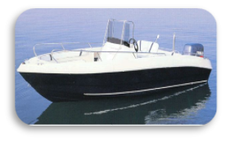
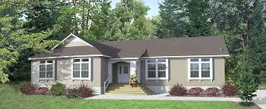
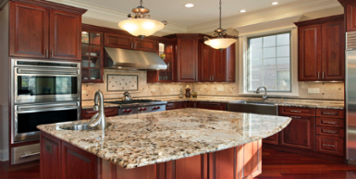


Market Platform
Lifestyle & Leisure
Marine
7%
of Patrick’s 2017 Sales
Industrial
11%
of Patrick’s 2017 Sales
RV
69%
of Patrick’s 2017 Sales
MH
13%
of Patrick’s 2017 Sales
Class A
Class C
Pontoon
Fiberglass
Folding Trailers
Aluminum
Fifth Wheel
Travel Trailer
Ski & Wake
Modular Structures
Residential Housing
Modular Housing
Commercial Fixtures
Manufactured Housing
Institutional Furniture
Housing & Industrial

Slide 10







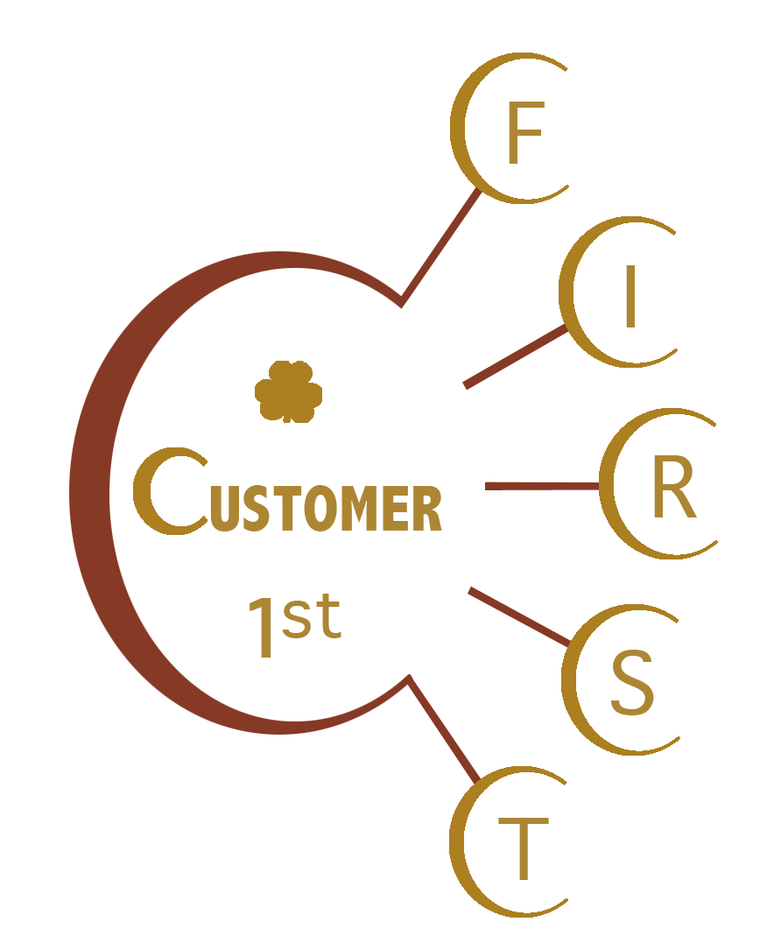


























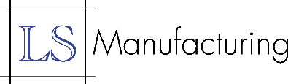












Strong Brands
Differentiated, customer-centric brand strategy and business model
Portfolio of brands enable OEM customers to differentiate their products to consumers
Brands retain significant autonomy to maintain entrepreneurial spirit and brand individuality enabling continuation of legacy value proposition with the support and opportunity to leverage all of Patrick’s resources

Slide 11
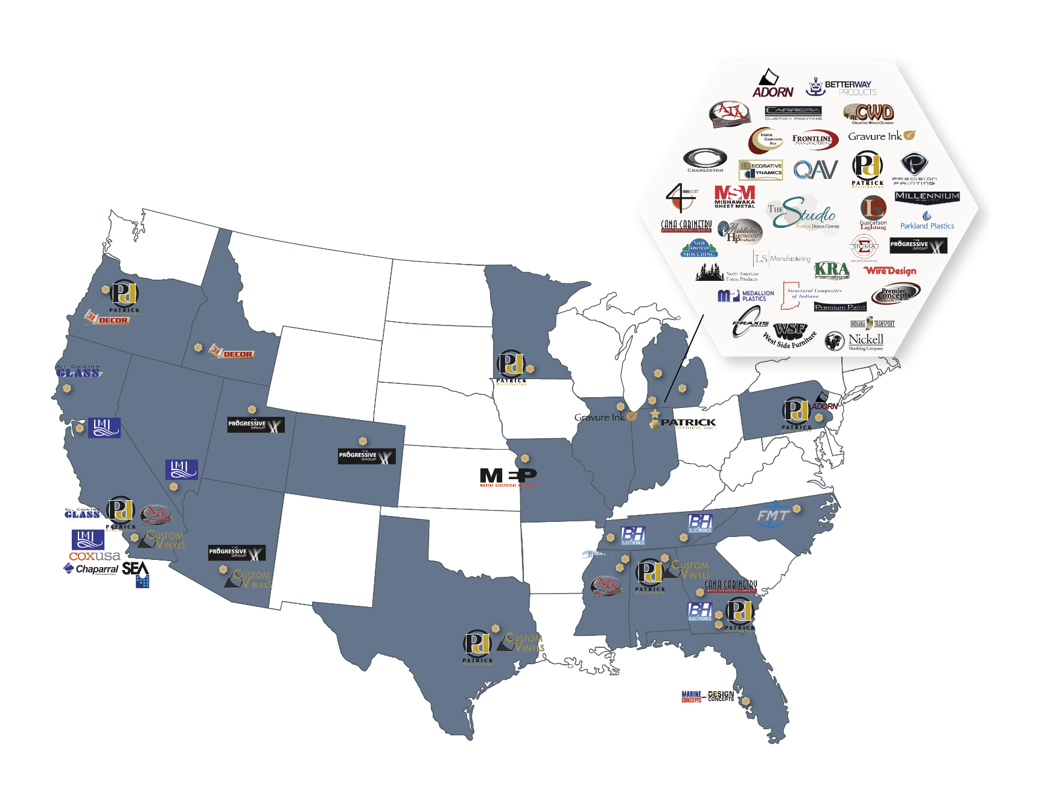
Patrick Facility Profile
Over 90 facilities in 20 states with approximately 6,800 employees
Headquarters
Existing Patrick Facility
Strategically aligned with OEM customers offering a nationwide network
*There is one manufacturing facility located in China that was part of the November 2017 LMI acquisition
11

Slide 12


Portfolio of Expertise with Key Capabilities
Lifestyle & Leisure
Housing & Industrial
 | RV | Marine | MH | Industrial
Plastics / Thermoforming
Furniture & Sourcing/Specialty Bath, Shower & Closet Systems
Solid Surface / Granite / Quartz Countertops & Fabrication
Metal Fabrication / Fuel Tanks
Fiberglass Component Products / Tooling / Hulls / Engineering & Design Services
Warehousing / Distribution / Logistics / Comprehensive Design Center
Electronics / Audio Systems / Appliances
Full & Partial Body Paint / FRP and Aluminum Sidewalls
Electrical / Wiring Solutions / Harnesses / Instrument Panels / Lighting
Hardwoods / Softwoods / Cabinetry
Lamination / Custom Components

Slide 13
Outperforming End-Market Growth
RV Sales Growth
MH Sales Growth
Industrial Sales Growth
($ in millions, shipments in thousands)
5-Year
($ in millions, shipments in thousands)
($ in millions, housing starts in thousands)
5-Year
5-Year
non-res construction spend (commercial), YoY chg.
33%
CAGR
+23%
CAGR
CAGR
37%
+17%
17%
+45%
26%
27%
+14%
+25%
+15%
+16%
9%
+13%
+37%
14%
27%
+12%
+15%
+12%
+12%
42%
+10%
+10%
61%
-1%
+10%
+7%
+5%
431
11%
+3%
+6%
321
357
374
-4%
252
286
Patrick RV sales growth has outpaced industry growth for five
consecutive years
Patrick MH sales growth has outpaced industry growth for five
consecutive years
Patrick Industrial sales growth has outpaced industry growth for five consecutive years
Source: RVIA RV Wholesale Shipments Historical Glance, RVIA December 2016 Market Report, Manufactured Housing Institute December 2016 Monthly Economic Report, U.S. Census Bureau New Privately Owned Housing Units Started Annual Data through 2016, U.S. Census Bureau Value of Construction Put in Place in the United States, Not Seasonally Adjusted, through November 2016
Note: Non-residential construction spend includes lodging, office, commercial, health care, education, religious and amusement and recreation; 2016 non-residential construction spend increase represents YTD through November 2016 compared to same period of 2015
13

Slide 14
Market Update:
Lifestyle & Leisure

Slide 15



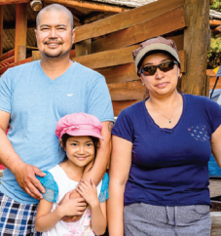

Demographic Trends
RV Market
Faces of New Campers
Favorable Demographic Trends
Growing Camping Activity
Overall camping experiences and RV awareness are driving growth among younger and more diverse participants
Younger campers looking for affordable recreation experience
38% of all campers are millennials (ages 18-35)
34% of new RVs sold in 2016 were to first time buyers
  8 out of 10 of those new buyers were under age 65
  Gen X and Millennials helping to drive this growth – making up 72% of new campers in 2016
37.1 million North American households camp at least once a year and 22% of them are RV campers
3.4 million new households have started camping since 2014
Latino, African American, Asian and other ethnicities represented 39% of new campers in 2016; 26% of all campers
All Campers
Millennials
Gen X
Boomer
Mature
Source: KOA North American Camping Report; RVIA

Slide 16


Market Stats
RV Market
TOWABLE
87% of industry 2016 unit sales
61% of estimated 2016 retail dollar sales, or $10.7 billion
Retail cost $5,000 to $160,000+ per unit
  Average $29,000
13% of industry 2016 unit sales
39% of estimated 2016 retail dollar sales, or $7.0 billion
Retail cost $43,000 to $500,000+ per unit
  Average $127,000
MOTORIZED
Source: RVIA 2016 Industry Profile

Slide 17
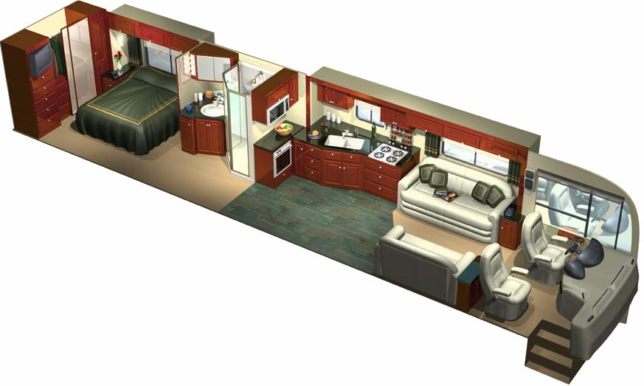
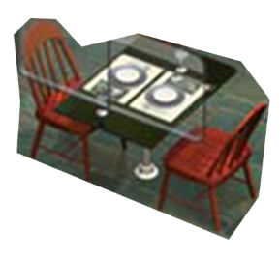
Patrick Product Lines – RV Interior
RV Market
Closet Hardware
Closet & Passage Doors
Fiberglass Bath Fixtures & Shower Doors
Cabinet Doors
Mattresses
Kitchen & Bath Faucets & Sinks
Electronics
Lighting
Vanity/Wall Mirrors
Microwaves
Laminated Panels & Printed Vinyl
Drawer Fronts & Sides
Laminate & Ceramic Flooring
Countertops
Backsplashes
Furniture
Speakers
Additional Supplied Products:
Exit Lighting
Ceiling Fans
Power Cords & Inlets
RV Tank Heater Pads
Fire Extinguishers
Electric Fireplaces
Wiring, Electrical & Plumbing Products
Inverters
Tire Pressure Monitors
Electrical Switches, Receptacles, and Outlets
RV Transfer Switches
Battery Selector Switches
Cut to size, boring, foiling & edge-banding
Flooring Adhesive
Instrument Panel
Made-to-order laminated products including vinyl,
paper, veneers and high pressure laminates (HPL)
Cabinet
Hardware
Window Trim
Under Cabinet Lighting
Slide trim – foam, hardwood, wrapped
Tile
Dinettes, Tables & Chairs
Hardwood Accessories

Slide 18
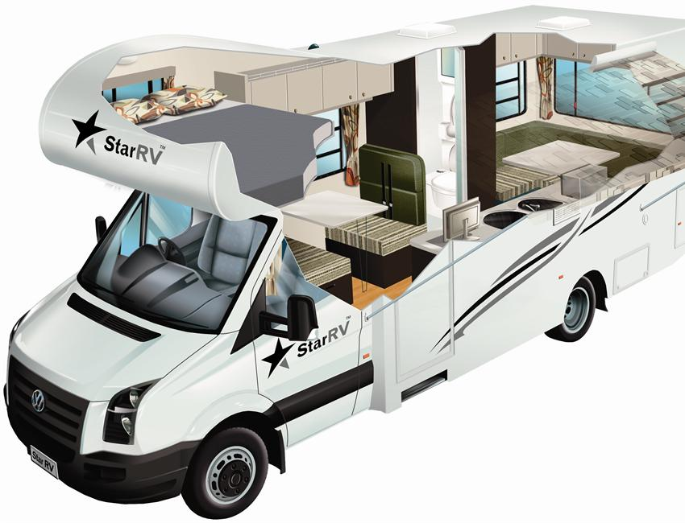
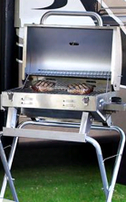
Patrick Product Lines – RV Exterior
RV Market
Front and Rear Caps
Bow Trusses
Exterior Speakers
Additional Product Lines:
Softwoods
Full Body Paint
Aluminum Gauges
Steel Gauges
Mill Finish & Pre- Painted Aluminum and Steel
Slit & Embossed Steel
FRP Coil & Sheet
RV Power Cords & Inlets
RV Grills & Accessories
Aluminum & FRP Side Walls
Motion Sensing Lights
Laminated Side Walls
LED Lighting
Paint & Paint Mask

Slide 19
Industry Outlook
RV Market
(shipments in thousands)
+5% annual growth
585
9/11 Attacks
Continued Favorable Macro Environment
Residential Housing Crisis
Strong consumer confidence
Relatively low interest rates
Lower, stable fuel prices
Credit availability
Favorable employment and wage trends
Strength in equity and housing markets
Canadian markets showing signs of improvement
Gulf War
It is our belief that trended shipment levels indicate continued potential for future growth trajectory based on current demographic indicators, discipline in the space, overall economic conditions and resilience and strength of the leisure lifestyle. Additionally, average shipment increases over each of the last prior peaks point to an extended runway with potential in excess of 580,000 units.
RV Shipments Source: 1990 – 2017 RVIA; 2018F - 2020F Company Estimates; Consumer Confidence Index: The Conference Board

Slide 20


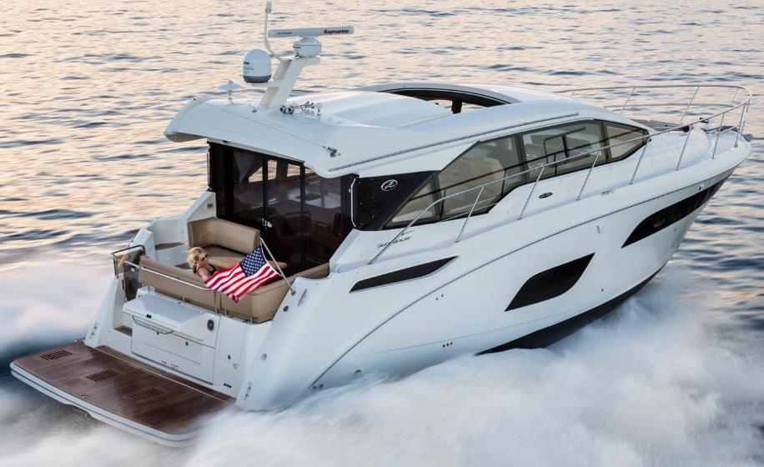

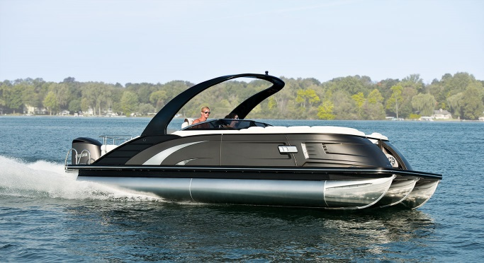

Overview
Marine Market
Statistics
36% of the U.S. adult population participated in recreational boating in 2016
Estimated 141.6 million people went boating in 2016
11.9 million registered powerboats in the U.S.
Outdoor Recreational Lifestyle
Continued core recreational boater demand
Three most popular boating activities: fishing, swimming & entertaining
Active, outdoor lifestyle continuing to grow, allowing for more time spent with family
Trends Influencing the Market
Average age of registered boats continues to increase
Innovative, versatile boats helping new generations become boaters
Younger demographics and families allocating more time to leisure activities
Source: National Marine Manufacturers Association (NMMA)

Slide 21
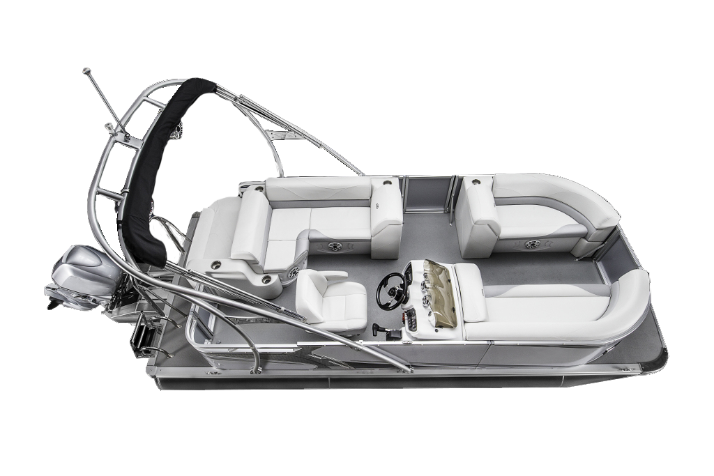
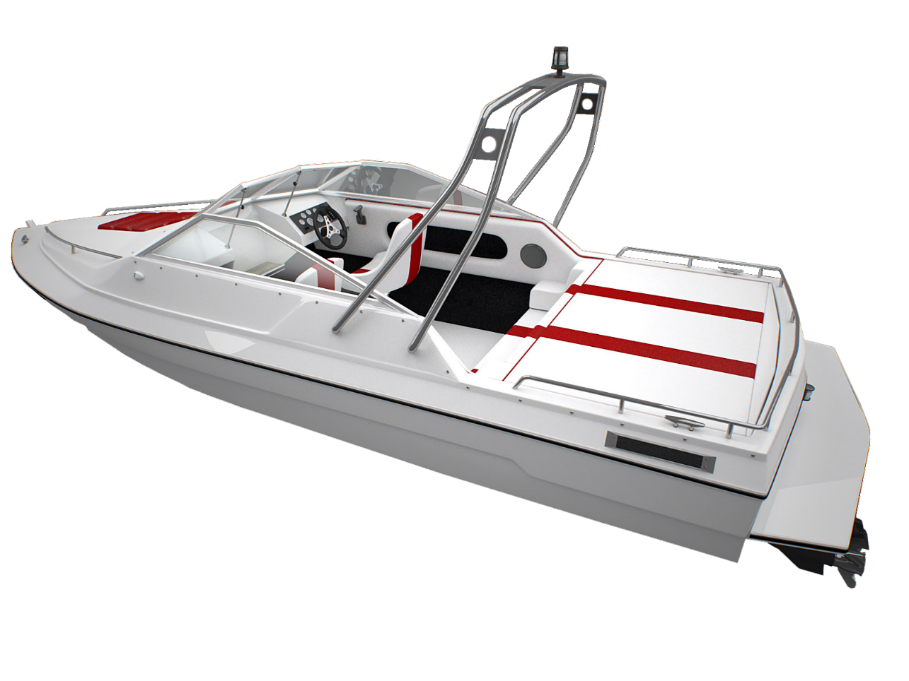
Marine Products
Marine Market
Electronics
Helms
Electronics
Dash Assemblies
Wire Harnesses
Wire Screens
Aluminum Fuel & Holding Tanks
Dash Assemblies
Marine Growth Potential:
Wind Shields (Glass)
Plastic fuel & holding tanks
Fuel system related components
Plastic seat bases and components
Vinyls (biminis, covers)
Fabricated & extruded aluminum
Decking, flooring, carpet, vinyls
Gauges, instrument panels, displays
Lighting
Steering and throttle controls
Accessories
Wire Harnesses
Boat Hull Design & Tooling
Aluminum Fuel & Holding Tanks

Slide 22
U.S. Marine Outlook
Marine Market
Industry Volume
Average age of a used boat is approximately 25 years
1965-1991
Average 401,000
1992-2006
Average 306,000
The U.S. marine market continues its steady recovery with the potential for a long runway of steady growth with leisure lifestyle attractiveness and an aging inventory of used boats
Source: NMMA (traditional powerboat retail excluding jet boats); 2017F is Company estimate

Slide 23
Market Update:
Housing & Industrial

Slide 24


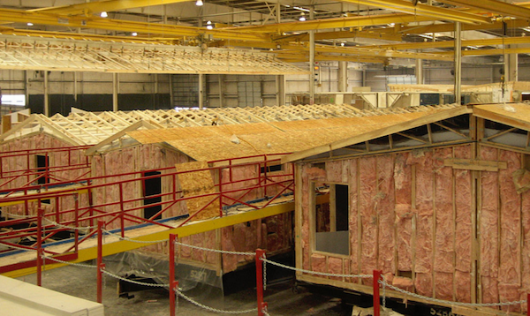

Overview
MH Market
Affordable Form of Home Ownership
Average structure cost per sq. ft. (2016) $48.82 (MH) vs. $107.18 (single family home)
Average MH retail price (2016) $70,600 for 1,446 sq. ft. (home only)
Statistics
Approximately 9 million households with 22 million people living in manufactured homes (9% of nation’s single family housing stock)
80% of all new homes sold under $150,000 are MH
Manufacturing
Flexible production process allows for more custom features at lower cost
Engineered for wind safety and energy efficiency based on geographic region
Source: Manufactured Housing Institute (MHI)

Slide 25
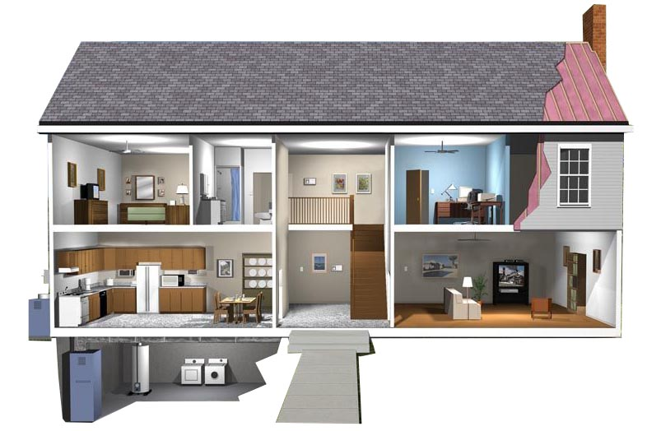
Patrick Product Lines – MH
MH Market
Kitchen & Bath Faucets & Sinks
Fiberglass Bath Fixtures & Shower Doors & Enclosures
Gypsum (Drywall & Drywall Finishing Products)
Wrapped Profile Moldings
Plumbing Products
Siding
Interior & Exterior Decorative Lighting Fixtures
Trusses
Ceiling Fans
Shingles
Ventilation System & Ridge Cap
Felt Paper
Ice & Water Protection
Drip Edge
Flashing
Roofing Membrane
Soffit & Fascia
Interior Passage Doors
Backsplashes
Medicine
Cabinets
Additional Supplied Products:
Building Arches
Closet Organization Products
Sealants
Innovative Lighting
Electrical Components
  Panels/Breakers
  Outlet Boxes
  Switches/Receptacles
Fireplaces and Surrounds
Made-to-order laminated products including vinyl, paper, veneers and high pressure laminates (HPL)
Cut to size, boring, foiling & edge-banding
Solid Surface, Granite and Quartz Fabrication
Flooring Adhesive
Tables & Signs
Roof Trusses
Wardrobe Doors & Hardware Systems
Closet Organizers & Shelving
Electronics
Printed Vinyl
Countertops
Tile
Recessed Lighting
Under Cabinet Lighting
Fluorescent Lighting
Wiring/Electrical Products
Laminate & Ceramic Flooring
Microwaves
Cabinet Doors & Components

Slide 26
Industry Outlook
MH Market
(shipments in thousands)
+15% annual growth
+10% annual growth
The MH industry continues to perform at historical lows reflecting the residual impacts from the residential housing market crash, including tight credit standards and lending. We believe, however, that there is pent-up demand and significant upside potential for this market based on current demographic trends, including multi-family housing capacity and improving consumer credit and financing conditions, among other factors.
Source: 1990-2016: MHI; 2017F - 2020F Company Estimates, NAHB

Slide 27

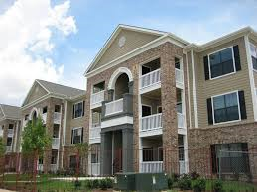
Residential End-Markets
Industrial Market
Product Lines:
    Kitchen cabinets and components
    Household furniture
    Solid surface countertops
    Shower doors
    Bathroom & closet systems
New housing starts are well below the prior peak and there continues to be pent-up demand, providing continued runway in new housing market
New housing demand on the West Coast has continued to increase as a % of new housing starts
Sources: New Housing Starts - U.S. Census Bureau; Existing Home Sales – National Association of Realtors; NAHB

Slide 28
Residential Home Buying Strength
Industrial Market
The key home buying population demographic began to increase in recent years following a 14 year decline
Sources: Euromonitor, BofA Merrill Lynch Global Research

Slide 29
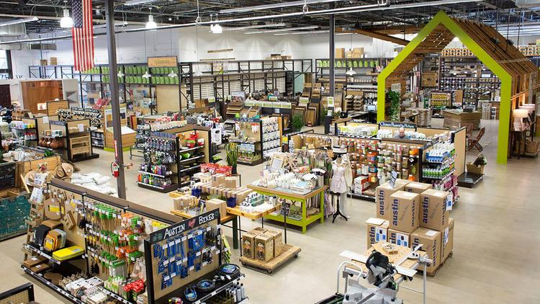

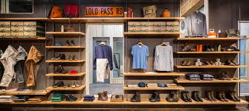

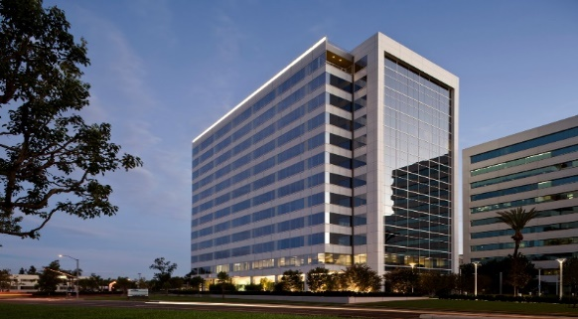

Non-Residential End-Markets
Industrial Market
Our current non-residential industrial strategy is to leverage our manufacturing and distribution capabilities, geographic footprint and product expertise to penetrate adjacent markets and identify new sales channels
Big Box Retail
Kitchen cabinets
Custom wardrobe and shower systems
Electronics distribution
Polymer-based wall panels, adhesives and accessories
Retail and Commercial Fixtures
Store fixtures
Slotwall
Casework and office furnishings
Solid surface countertops
High Rise, Office, Hospitality, Schools & Universities
Office furniture & cabinets
Solid surface, granite, & quartz countertops
Polymer-based wall and ceiling panels and other accessories
Bath and shower surrounds & wardrobe systems

Slide 30
Capital Allocation Strategy

Slide 31
Focused Capital Allocation
Our capital allocation strategy is centered around the utilization of a balanced leverage position, strong cash flows and capital resources to grow and reinvest in the business model
Acquisitions
Capital Expenditures
Expansions
Stock Repurchases
Debt Reduction
Execute disciplined strategic acquisition program in core markets
Invest in internal growth and cost saving opportunities including product extensions, infrastructure and expansions
Maintain efficient and flexible balance sheet through disciplined use of cash flows and leverage to drive growth and strong ROIC
Focus on geographic expansion opportunities to leverage our existing relationships and expertise
Return excess capital to shareholders through share repurchases
Use strong cash flow to reduce debt and reload growth capacity

Slide 32































Leverage Capacity
We expect to continue to utilize our leverage and cash flow in alignment with our capital allocation strategy
⁽¹⁾
Total Consolidated Leverage
$10MM of
Acquisitions &
$94MM Equity Offering
$30MM of
Acquisitions
$17MM of
Acquisitions
$72MM of
Acquisitions
$17MM of
Acquisitions
$140MM of
Acquisitions
$88MM of
Acquisitions
Target Leverage Range
(1) Leverage is the consolidated total indebtedness to consolidated adjusted EBITDA as defined by the 2015 Credit Agreement per Company 10-Q

Slide 33
Acquisition Strategy
Goals
Target Attributes
Integration Model
Introduce new, innovative product lines complementary to core competencies
Solid management teams
Allow creative entrepreneurial spirit to continue to thrive
Strong customer and supplier relationships and operational talent
Retain brand name given customer equity
Cross sell extensive product catalog to customer base
Provide capital, administrative and operational support
where needed
Increase content per unit
High quality product lines
Leverage management capabilities
Strong growth potential
Capture cost synergies
Provide “Good” / “Better” / “Best” Product Offerings
Strategic value proposition
Drive revenue synergies through sales coordination across broader Patrick customer base
Expand into adjacent markets to further leverage core manufacturing and distribution capabilities, gain new growth platforms and diversify end-market exposure
Any size but very fine filter for large opportunities

Slide 34
Acquisition Summary by Year
From 2014 – 2017…
We have executed on 21 acquisitions, acquiring 29 different companies with total revenues of ~$850 million
Averaged 5 acquisitions with ~$212 million in annualized acquired revenue over the last four years

Slide 35
Demonstrated Ability to Source, Acquire and Integrate
Increasingly executing on opportunities across diverse end-markets
Acquisition Momentum
$236MM Avg. Revenues Acquired
Acquisition End-Market Mix
($ in millions)
$59MM Avg. Revenues Acquired
# of Companies:
2 3 4 3 7 4 8 13
    Commitment to expanding product portfolio within our core markets has resulted in over 40 strategic acquisitions since 2010
    Since 2010, Patrick’s acquisitions have provided ~$1B in annualized revenue (at the time of acquisition)
    Averaged ~$236MM in annualized acquired revenues in last 3 years

Slide 36



















































Strong Brands & Product Expertise in Core Markets
Recreational Vehicle
Marine
Lifestyle & Leisure
Manufactured Housing
Industrial
Housing & Industrial

Slide 37
Geographic and Product Expansion
Focus on expansion opportunities with $250MM market potential
Targeted Product Lines:
Lamination
Aluminum
FRP
Fiberglass
Paint
Shower Doors
Solid Surface
Hardwood Products
Pressed Products
Interior Doors
Plastics
Bath & Closet Systems
PACIFIC NORTHWEST
1
SOUTHERN CALIFORNIA
2
1
TEXAS
5
3
SOUTHEAST
4
2
4
NORTHEAST
3
5
Financial Overview

Slide 38
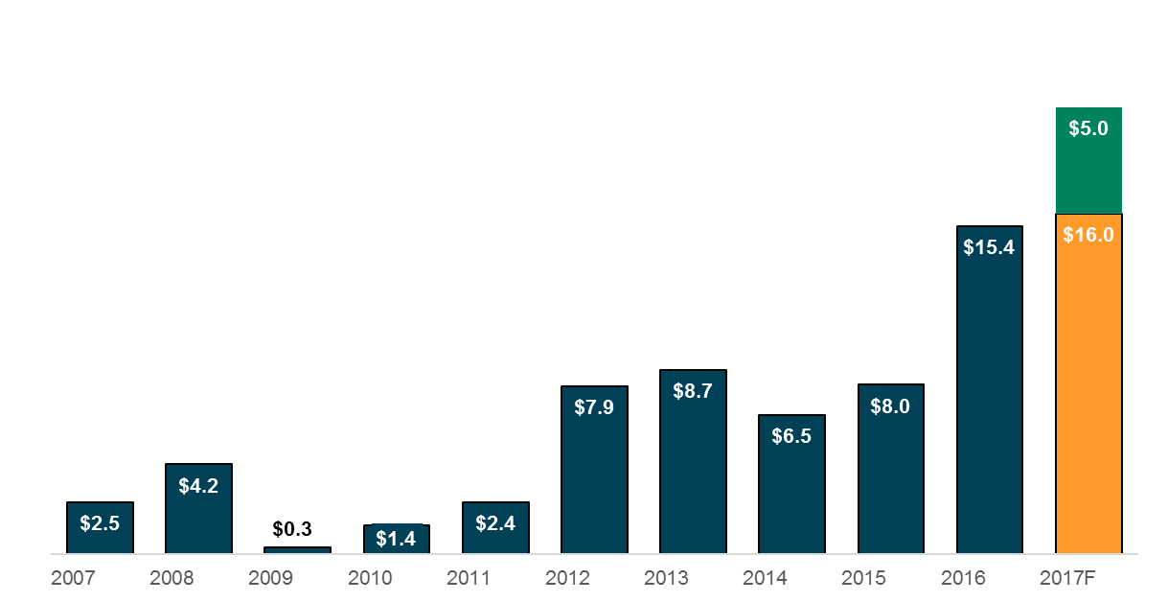
Capital Expenditures
($ in millions)
  Strategic
  Capex
Strategic Capital Spending:
  New Process / Automation
  Increased Capacity
  Increased Efficiencies
  We will continue to invest in our infrastructure to drive efficiency and capacity and flex our capital spend when necessary to align with our demand levels

Slide 39
Questions?

