Slide 1
Breakthrough CFO Leadership During Transformation
August 15, 2018
David Porter, CPA, CMA, CGMA
President, David Porter Advisors, LLC
Notes:
Over 70% of transformations fail to achieve their original goals.
Over 80% of M&A activity falls short of the original deal books.
What’s going on here and how can CFO’s position themselves to help?
Transformations are personal to me because they result in us leaving the people and the place either better or worse for having done the work.
GE change equation: Q X A = E
Quality of the technical solution times the acceptance by the team equals the effectiveness of the project/transformation
One of the big mistakes of a transformation is putting process before people

Slide 2
Today’s Topics
CFO — A transformational role
Why transformations fail
Why transformations succeed
Trust equation
Behaviors that build trust
Decision-making and its challenges
Change communication model

Slide 3
If you don’t like something, change it. If you can’t change it, change your attitude.
Maya Angelou
Notes:
The takeaway: The most effective transformation leaders know they need to change themselves first before helping others do the same.

Slide 4

CFO—A Transformational Role
Setting and measuring performance goals
Focusing resources on highest-value projects rather than most visible or biggest
Providing timely, relevant line of sight on costs/benefits across functions
Acting like a private equity firm
Ensuring that benefits make it to EBITDA
Notes:
3. Single version of the truth especially important in keeping transformations moving forward
Finding the value
Defining the master plan
Enabling execution
Partnering for performance
All to optimize total shareholder return

Slide 5
CFO—A Transformational Role
Developing finance team skills and mindsets to support the broader transformation
Impartial business advisor with a value-creation lens
Chief Performance Officer to establish KPIs for value creation and operational excellence
Communicates transformation value
Coach, catalyst, and simplifier
Notes:
What are some other things you believe a CFO should do during a transformation?
Catalyst: Stimulate and drive timely execution of change in finance and the organization.
8. CPO: Milestone-oriented KPIs that promote value creation priorities and proactively manage performance and enforce consequences
9. Communicator of transformation value inside and outside. Promotes, empowers project teams, support for resolving issues, making decisions, removing obstacles
10. Often the CFO becomes the center of respectful straight talk.
10. Deloitte CFO Signals survey indicates CFO’s aspire to spend 60% of their time as a change catalyst and strategist
To do this, the CFO must go well beyond the numbers. Today we will talk about what that looks like.

Slide 6

McKinsey’s Five Frames
Set goals
Assess organization capabilities
Design transformation initiatives
Execute
Sustain the changes
Action on all five frames = 72% success rate (26% without)
Notes:
CFO’s provide a baseline for performance and top-down targets for the transformation
CFO’s play a key role in performance assessment
CFO’s create milestone-based KPI’s that clarify requirements and provide consequences. They help prioritize initiatives that drive value and stop the things that don’t.
They can provide coaching, remove obstacles, make decisions and resolve issues
Maintaining the financial discipline and reminding everyone that making sure the transformation gains fall to the bottom line is critical.

Slide 7
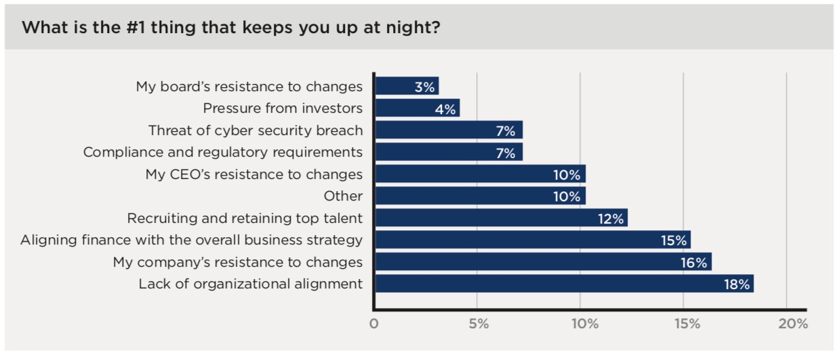
People
Decision-making
Trust
Communication
Top four are critical barriers to transformation success
Notes:
Korn Ferry CFO Pulse Survey 2018

Slide 8
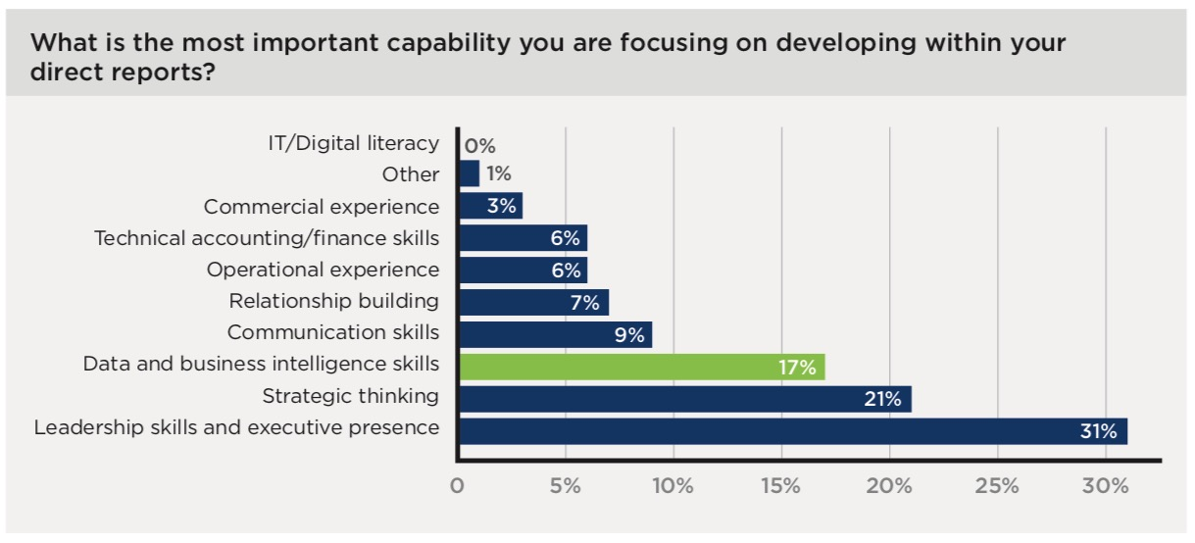
Leadership skills and executive presence have 3X focus over communication and 4X over relationship building
Notes:
Korn Ferry CFO Pulse Survey 2018
Point: Are these skills under-focused due to important or comfort level? The CFO’s don’t know how to address and coach?

Slide 9
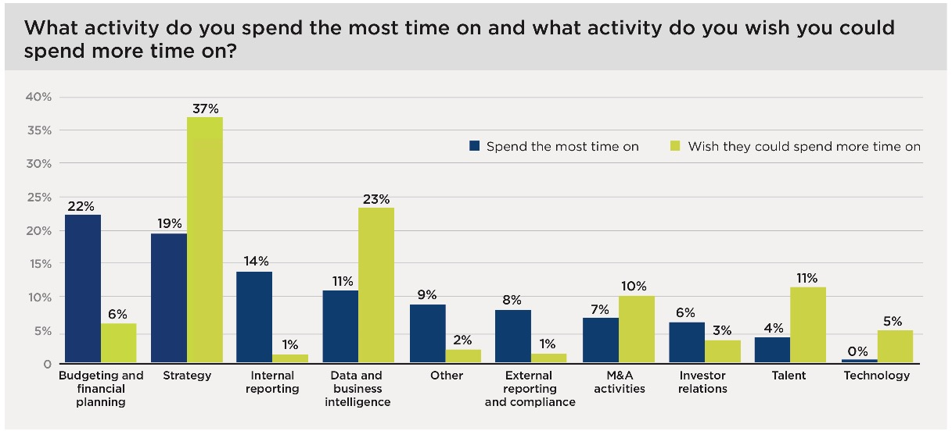
What enables a company to deliver its strategy and develop its business intelligence?
Notes:
Korn Ferry CFO Pulse Survey 2018

Slide 10
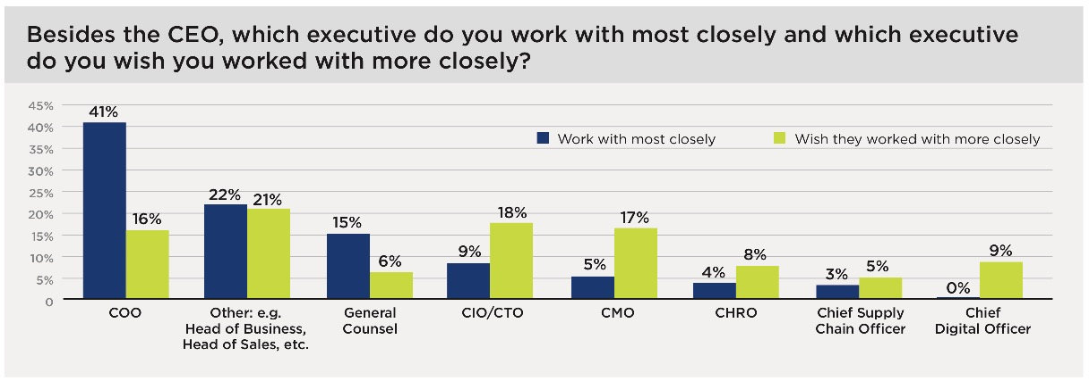
If talent matters to the CEO, the CFO and CHRO are working in lockstep to help transform the company
Notes:
Korn Ferry CFO Pulse Survey 2018

Slide 11
Why transformations fail
Competing priorities
Low-trust environment
Reluctant decision making
Lack of customer-focused vision
Ineffective communication
Notes:
The CFO can help by reiterating the sense of urgency and continuous improvement mindset at the C-level, by demanding that new targets that reflect the improvements are baked into the budgets in future years, and by sharing the stories, perhaps their own, about what happens when complacency replaces urgency. The importance of buy-in by line managers should be emphasized as no change sustains if the people with line-of-sight to the customer are not on board.
Declining financial discipline: We don’t reset budgets and targets to EXPECT the gains to be sustained from the improvements and inertia wins.
Quitting while ahead: Early gains taken for granted and not sustained

Slide 12
Why transformations fail
Insufficient employee engagement
Declining financial discipline
Surrendering to change fatigue
Quitting while ahead
CEO turnover
Notes:
The CFO can help by reiterating the sense of urgency and continuous improvement mindset at the C-level, by demanding that new targets that reflect the improvements are baked into the budgets in future years, and by sharing the stories, perhaps their own, about what happens when complacency replaces urgency. The importance of buy-in by line managers should be emphasized as no change sustains if the people with line-of-sight to the customer are not on board.
Declining financial discipline: We don’t reset budgets and targets to EXPECT the gains to be sustained from the improvements and inertia wins.
Quitting while ahead: Early gains taken for granted and not sustained

Slide 13
Why transformations succeed
Senior leaders continuously communicate transparently and everywhere
Trust is established and expanded
Decision-making is designed and deliberate
Leaders role model new behaviors
Everyone tells a consistent change story
We drive multiple actions during and after transformation
All leadership happens during conversation
Notes:
Communication equals speaking and listening. It is a two-way exchange of information.
Role model: Leaders must work on themselves first
Drive multiple actions: Make it stick and overcome inevitable inertia
We will spend most of our time together today on trust, communication and decision-making. Whatever your technical skills that allow you to be a great financial professional, these two areas are key to success or failure. This is generally true, and doubly so in transformations.

Slide 14
Trust Equation
Credibility
Reliability
Intimacy
Higher is Better
Self-Orientation
Lower is Better
Notes:
EXERCISE: Based upon this description, I’d like you to think about a work relationship that isn’t going as well as you’d like. Once you have that in mind, I’d like you to consider this question: In which box of the trust equation do you think the other person is exhibiting behavior that hurts their trustworthiness? One more question: In which box of the trust equation do you think you are exhibiting behavior toward this person that makes you less trustworthy?
Trust is, by definition, a two-way, high-risk street. It’s easy to judge others by their behavior. At the same time we often judge ourselves by our intent, not our behavior. How we are showing up to the relationship matters.

Slide 15
Trust Equation: Questions
Credibility
Reliability
Intimacy
Higher is Better
Does he know the subject matter?
Is she an expert in the field?
Does she do what she says she will do?
Will he let me down?
Do I feel comfortable and connected with him?
Do I feel safe with her?
Does he dominate the discussion?
Does he compete for attention and recognition?
Does she hoard ideas and information?
Does he frequently rush to solutions?
Lower is Better
Self-Orientation
Notes:
Credibility is about what we know and the words we use.
Reliability is about what we do, our actions and resulting dependability
Increasing Intimacy is about safety or security we feel when entrusting someone. How safe people feel to share with you.
Self-orientation is about our focus. It, along with intimacy, is the toughest, yet effective way to leverage our leadership effectiveness

Slide 16
Trust Equation: Skills
Credibility
Reliability
Intimacy
Higher is Better
Develop mastery in your field
Keep current with trends and news
Develop a teachable point of view and share it
Say “I don’t know”
Define expectations and report progress frequently
Make many small promises and follow through
Communicate delays and take responsibility
Respect others’ culture and approaches
Tell others what you appreciate about them
Know and use their name
Share something personal
Name the elephant in the room
Ask many questions
Listen even when uncomfortable
Speak difficult truths, even when awkward
Give others the credit
Self-Orientation
Lower is Better

Slide 17
Elements of courageous leadership
Display vulnerability
Become a role model for excellence
Take a committed stand
Do the right thing
Raise our standards
Use respectful straight talk
Notes:
We can build our own trustworthiness by being more courageous in our leadership. It’s important to have the courage of our talent and not keep what we are capable of under wraps.
By working on these 6 elements, we increase our trustworthiness and our leadership effectiveness.
I want to dive into one of the elements more deeply. How we use respectful straight talk. (next slide)

Slide 18

Respectful straight talk
Leave discussion with a better relationship
Tell the truth and ask for help
Hold timely discussions about performance issues
Speak face-to-face about sensitive issues
Coaches without judgment and makes distinctions about behavior
Conveys the power of shared values by living them
Defines unacceptable behaviors and follows through
Favors plain talk vs management-speak

Slide 19
The Power of Why
Always share the “why”
Repeat the message
How many times do I have to repeat myself?!
Notes:
People intrinsically want to be part of something bigger than them. Telling people why something needs to be done helps them connect to a worthwhile goal.
Clarify and repeat the “why” to make sure it is understood and accepted
Repeat yourself: Repetition is the mother of all skill
When we are tired of our message, people are just beginning to hear it

Slide 20
Babies and change
Emotions are not rational
Emotions move us
All of us!
All of the time!
Capturing hearts and minds creates engagement
Notes:
Pleasure and pain

Slide 21
Essence of Decision-Making
Sound decision-making at its core:
  Data-driven but not over-analyzed
  Process-based with natural intelligence
  Emotions managed
  Values-based over formulaic
  Flexibility to handle VUCA

Slide 22
Dealing with VUCA
Uncertain
Complex
Ambiguous
Situations
Volatile
Ambiguous
Strategic skills
Innovation
Agility
Resilience
Notes:
Volatile: Change is rapid and unpredictable in its nature and extent
Uncertain: The present is unclear and the future is uncertain
Complex: Many different, interconnected factors come into play, with the potential to cause chaos and confusion
Ambiguous: There is a lack of clarity or awareness about situations
Innovation: Inventing the future
Agility: Avoiding punches
Resilience: Getting back up
The point is that new skills, approaches and behaviors are required to manage VUCA

Slide 23

Decision-Making Challenge
In a CIMA study, global companies struggle to:
  Overcome bureaucracy and achieve agile decision making
  Build greater levels of trust and improve collaboration
  Take a long-term view and define the right metrics
  Turn huge volumes of data into strategic insight
  Build the decision-making skills of senior leaders
Source: Joining the Dots: Decision Making for a New Era. Chartered Institute of Management Accountants. February 2016

Slide 24
Study findings
The study reveals:
  72% had 1 or more strategic initiative failure in last 3 years due to delays
  42% lost business to more agile competitors
  70% room to improve active collaboration between leaders and employees
  65% say the same about trust
  57% see a need to improve active collaboration with fellow executives
Source: Joining the Dots: Decision Making for a New Era. Chartered Institute of Management Accountants. February 2016

Slide 25
Decision-Making Insights
  We are terrible at predicting the future
  We tend to be overconfident
  We don’t suffer from confirmation bias, we embrace it
  Halo effect happens to our detriment
  Priming entangles us and we rarely escape its grip
Notes:
Predicting the future; Tetlock’s research demonstrated that experts’ predictions are worse than simple extrapolations from base rates
Overconfident: We tend to think we know more than we do about how the future will unfold (Doctors who rated themselves completely certain were wrong 40% of the time)
We analyze options but gather only or mostly self-serving information (not disconfirming)
We have a favorable impression about someone and assign credit to anything asked about them or said by them.
Is the height of the tallest redwood more or less than 1,200 feet? Or 180 feet? What is your best guess about the height of the tallest redwood. 1200 guessed a mean of 844 and 180 guessed 282 (a priming effect of 55%)

Slide 26
Ohio State Study on Decisions
  356 decisions in small and medium-sized businesses in the US and Canada
  Over 50% of decisions failed
  Only 29% of organizations considered >1 alternative
Notes:
Dr. Paul C. Nutt studied 356 decisions in small and medium-sized businesses in the US and Canada. 50% failed due to manager-imposed solutions, managers limit search for alternatives, and use power to implement their plan.
Successful managers:
Personally manage their DM processes
Search for understanding
Establish direction with an intervention and objective (intervention is creating a sense of urgency by establishing existing performance is inadequate)
Stress idea creation and implementation. The DM process should guide thinking about taking action

Slide 27
OSU Study: Successful Decision-Making Behaviors
Personally manage the decision-making process
Search for understanding
Establish direction and create sense of urgency
Emphasize idea creation
Think about implementation and taking action
Notes:
Paul C. Nutt studied 356 decisions in small and medium-sized businesses in the US and Canada. 50% failed due to manager-imposed solutions, managers limit search for alternatives, and use power to implement their plan.
Successful managers:
Personally manage their DM processes
Search for understanding
Establish direction with an intervention and objective (intervention is creating a sense of urgency by establishing existing performance is inadequate)
Stress idea creation and implementation. The DM process should guide thinking about taking action

Slide 28
Classic Decision-Making Model
Observe
Gather info
Orient
Interpret the situation
Decide
Repeated best guesses
Act
Implement the best decision
Notes:
Course leader:
Plan: Identify and analyze the problem or opportunity, develop hypotheses about what the issues may be, and decide which one to test
Do: Test the potential solution, ideally on a small scale, and measure the results (Do= try or test, not fully implement. That happens at the Act stage)
Check/Study: Study the result, measure effectiveness, and decide whether the hypothesis is supported or not
Act: If the solution was successful, implement it

Slide 29
Rapid Decision Making
Problem
Decision
Actions
Results
Big Whys
Support
Decision
Oppose
Fears
Common Big Whys
New product
New client
On-time projects
New pricing model
team effectiveness
Create new market
Need merger/acquisition
Competitive threat
Risk to IP
market share
Common Fears
Mistrust
Being wrong
Upsetting the boss
Looking bad
Losing my job
Imposter syndrome
Not enough data
Loss of power
Loss of prestige
Potential Decision Impacts
Decision speed
Decision quality
Financial – Revenue, cost, profits, cash flow
Timeliness – deal quality changes
Number and quality of available options
Potential high cost of doing nothing (CODN)
Notes:
A big why is helpful to create the urgency required for rapid decision-making. Big whys become musts rather than shoulds.
On the other side, fears slow down decision making, so dealing with them reduces their power over us.

Slide 30
Rapid Action Taking
Problem
Actions
Decision
Actions
Results
Resources
Support
Actions
Oppose
Obstacles
Resources
Foundation of trust
Courageous leaders
Right people
Role clarity
Realistic plan
Clear process
Goal alignment
Communication plan
Owner/CEO support
Leadership buy-in
Employee buy-in
Obstacles
Ineffective communication
The Kiss of Yes
Competing priorities
Fear of failing
Ill-defined processes
Poor planning
Low/no leadership buy-in
Low/no employee buy-in
Fear disguised as risk
Potential Action Impacts
Execution speed
Implementation cost – Revenue, profits, cash flow (direct and indirect)
Timely completion and expected results
Execution quality
Solution stickiness after implementation
Highlights cost of doing everything
Notes:
Once a decision is made to move forward, we take action. And action also has resources to work toward our goal and obstacles that slow us down. The key to leadership is exploiting the resource advantage while removing the barriers (or obstacles) to our success.
Use the resources as a playlist of possibilities to clear the way for action.
Use the obstacles as a way to focus discussions on the right issues that are stopping the team.

Slide 31
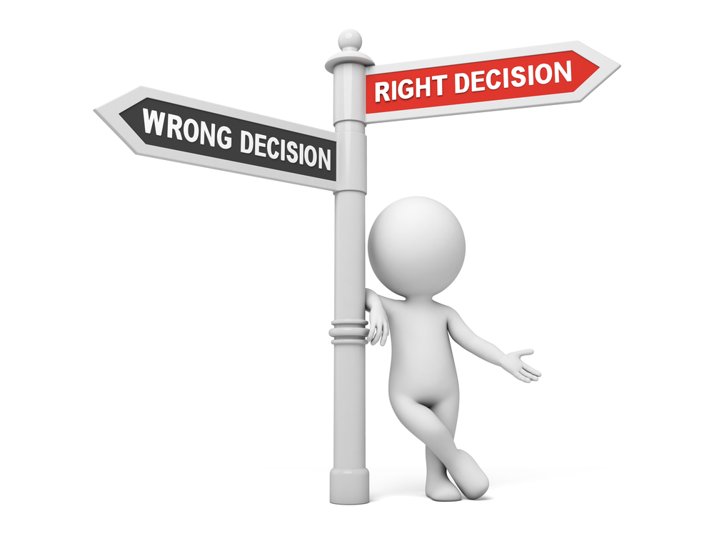
What are some useful tactics for effective decisions?

Slide 32
Decision-making tactics
  Process = 6X analysis
    Create a decision effectiveness model
Notes:
Process=6X importance of analysis (Knowing we are near-sighted does not correct our vision)
Make it safe
Increased openness to input and challenge: Gary Klein: Curiosity is a counterforce for contempt when people are making unpopular statements.
Better collaboration w/other leaders
Increased collaboration with employees (diverse POV, higher buy-in during implementation, most stickiness over time)
Clearly communicate and own the decision (telling the why and what enhances trustworthiness of the leaders, reduces cynicism, increases engagement)
Learning from outcomes: pre-mortem and post-mortem

Slide 33
Decision Effectiveness Model
Alignment
Understanding
Transparency
Engagement
Owning
Agreeing
Decision Effectiveness
Knowing
Showing
Notes:
Create greater transparency into how and why decisions are being made for deeper understanding of business model and employee alignment toward common goals which drives increased engagement in the implementation of the decision

Slide 34
Decision-making tactics
  Process = 6X analysis
    Create a decision effectiveness model
    Multiple views of same problem
    Decision rights model
Notes:
Multiple views: Multitracking considers more than one option at the same time
Minimizes politics and egos don’t get tied up in a single option
Example: Not 24 jams, 6 jams

Slide 35
Revisiting a Popular Model: RACI
Responsible
Accountable
Consult
Inform
Consult
Decide
Takeaway: Clarity clears the path for decisions
Notes:
This is likely a familiar model to you. The distinction I want to make is about responsible and accountable. Many leaders are accountable for a result and believe they are also responsible to do the work to achieve that result. This may be necessary at times, but to leverage your time and skills as a leader requires you to delegate responsibility to your team. As a bonus, this is the principal way they learn, contribute, and grow. And it also increases their engagement.

Slide 36
Decision-making tactics
  Process = 6X analysis
    Create a decision effectiveness model
    Multiple views of same problem
    Decision rights model
  Create safety and reward input and alternative views
  Build trust between leaders
Notes:
Process=6X importance of analysis (Knowing we are near-sighted does not correct our vision)
Make it safe
Increased openness to input and challenge: Gary Klein: Curiosity is a counterforce for contempt when people are making unpopular statements.
Better collaboration w/other leaders
Increased collaboration with employees (diverse POV, higher buy-in during implementation, most stickiness over time)
Clearly communicate and own the decision (telling the why and what enhances trustworthiness of the leaders, reduces cynicism, increases engagement)
Learning from outcomes: pre-mortem and post-mortem

Slide 37
Decision-making tactics
  Process = 6X analysis
    Create a decision effectiveness model
    Multiple views of same problem
    Decision rights model
  Create safety and reward input and alternative views
  Build trust between leaders
  Increase trust with employees
  Clearly communicate
  Own the decision
  Learn and integrate the outcomes
Notes:
Process=6X importance of analysis (Knowing we are near-sighted does not correct our vision)
Make it safe
Increased openness to input and challenge: Gary Klein: Curiosity is a counterforce for contempt when people are making unpopular statements.
Better collaboration w/other leaders
Increased collaboration with employees (diverse POV, higher buy-in during implementation, most stickiness over time)
Clearly communicate and own the decision (telling the why and what enhances trustworthiness of the leaders, reduces cynicism, increases engagement)
Learning from outcomes: pre-mortem and post-mortem

Slide 38
Decision-making tactics
  Vanishing options test
  Whether or not warning bell
  Look inside for bright spots
  Trying things beats forecasts (Know v. predict)
  10/10/10
  David Lee Roth it
Notes:
Look at options and take everything away. What do we do instead?
Whether or not is one option, not two
How do we feel 10 minutes from now? 10 months? 10 years? Gives us distance on our decisions

Slide 39
Great decision-making questions
  What would my successor do?
  What would have to be true for this option to be the best choice?
  What are the base rates for this decision?
  What would I tell my best friend to do in this situation?
  Default to core values: What kind of person do you want to be? What kind of organization do you want to build?
  What am I willing to stop doing to make room for my real priorities?
  Am I thinking too much? Am I thinking to little?
  What needs to happen to support our vision?
Notes:
Successor do? Moves beyond emotion and ego
What would have to be true? Avoid going too narrow, too soon
What are the base rates? Extrapolations and outside experts tend to be accurate about base rates. Helps check for reasonableness
What would I tell my best friend to do? Helps focus on the real challenge
Core values: Struggling to make a decision often comes down to lack of clarity on values. Once you evaluate using the values, the decision becomes clear
Stop doing: One of the most difficult things we do as leaders is make a decision to stop doing something that’s good for something that’s better. Status quo bias is strong
Too much or too little: Worth asking before a final decision is made. It’s subjective but may highlight analysis paralysis or a rush to judgment

Slide 40
The single biggest problem in communication is the illusion that it has taken place.
George Bernard Shaw

Slide 41
The role of fear
We work hard to avoid pain
Headphone spacer error
Poor strategy Poor preparation
Communication skill is a muscle
Notes:
1. We like looking good and being right. But we go out of our way to avoid embarrassment, being wrong, looking bad, feeling silly, etc. AVOIDING PAIN KEEPS US FROM OUR BEST WORK
2. Headset spacer error: We are wired to automatically respond to threats, even the ones we make up in our heads.
3. Strategy: The lack of a strategy—What we will do in our communication or stop doing creates more uncertainty and fear
4. Communication skills: Expands by demand like a muscle, strengthening our abilities.
The fearless leader doesn’t exist. Courageous leaders act through the fear by setting high standards, doing the right thing, using respectful straight talk, displaying vulnerability, taking committed stands, and role modeling excellence.

Slide 42
Being a courageous leader
Raise our standards
Do the right thing
Use respectful straight talk
Display vulnerability
Take a committed stand
Become a role model for excellence
For courageous leaders…
…outcomes are greater than fears
Notes:
The fearless leader doesn’t exist. Courageous leaders act through the fear by setting high standards, doing the right thing, using respectful straight talk, displaying vulnerability, taking committed stands, and role modeling excellence.

Slide 43
5 stages of effective change communication
Confusion Zone
or Resistance Zone
Awareness
Acceptance
Commitment
Engagement
Understanding
High Performance Zone
Notes:
The key is to make sure we are having the right conversation at the right time with the right person.

Slide 44
Stage 1: Awareness
Awareness
Acceptance
Commitment
Engagement
Understanding
Every message starts here
Brains flood with questions
Notes:
Be open to adaptive moves as questions are asked and answered

Slide 45
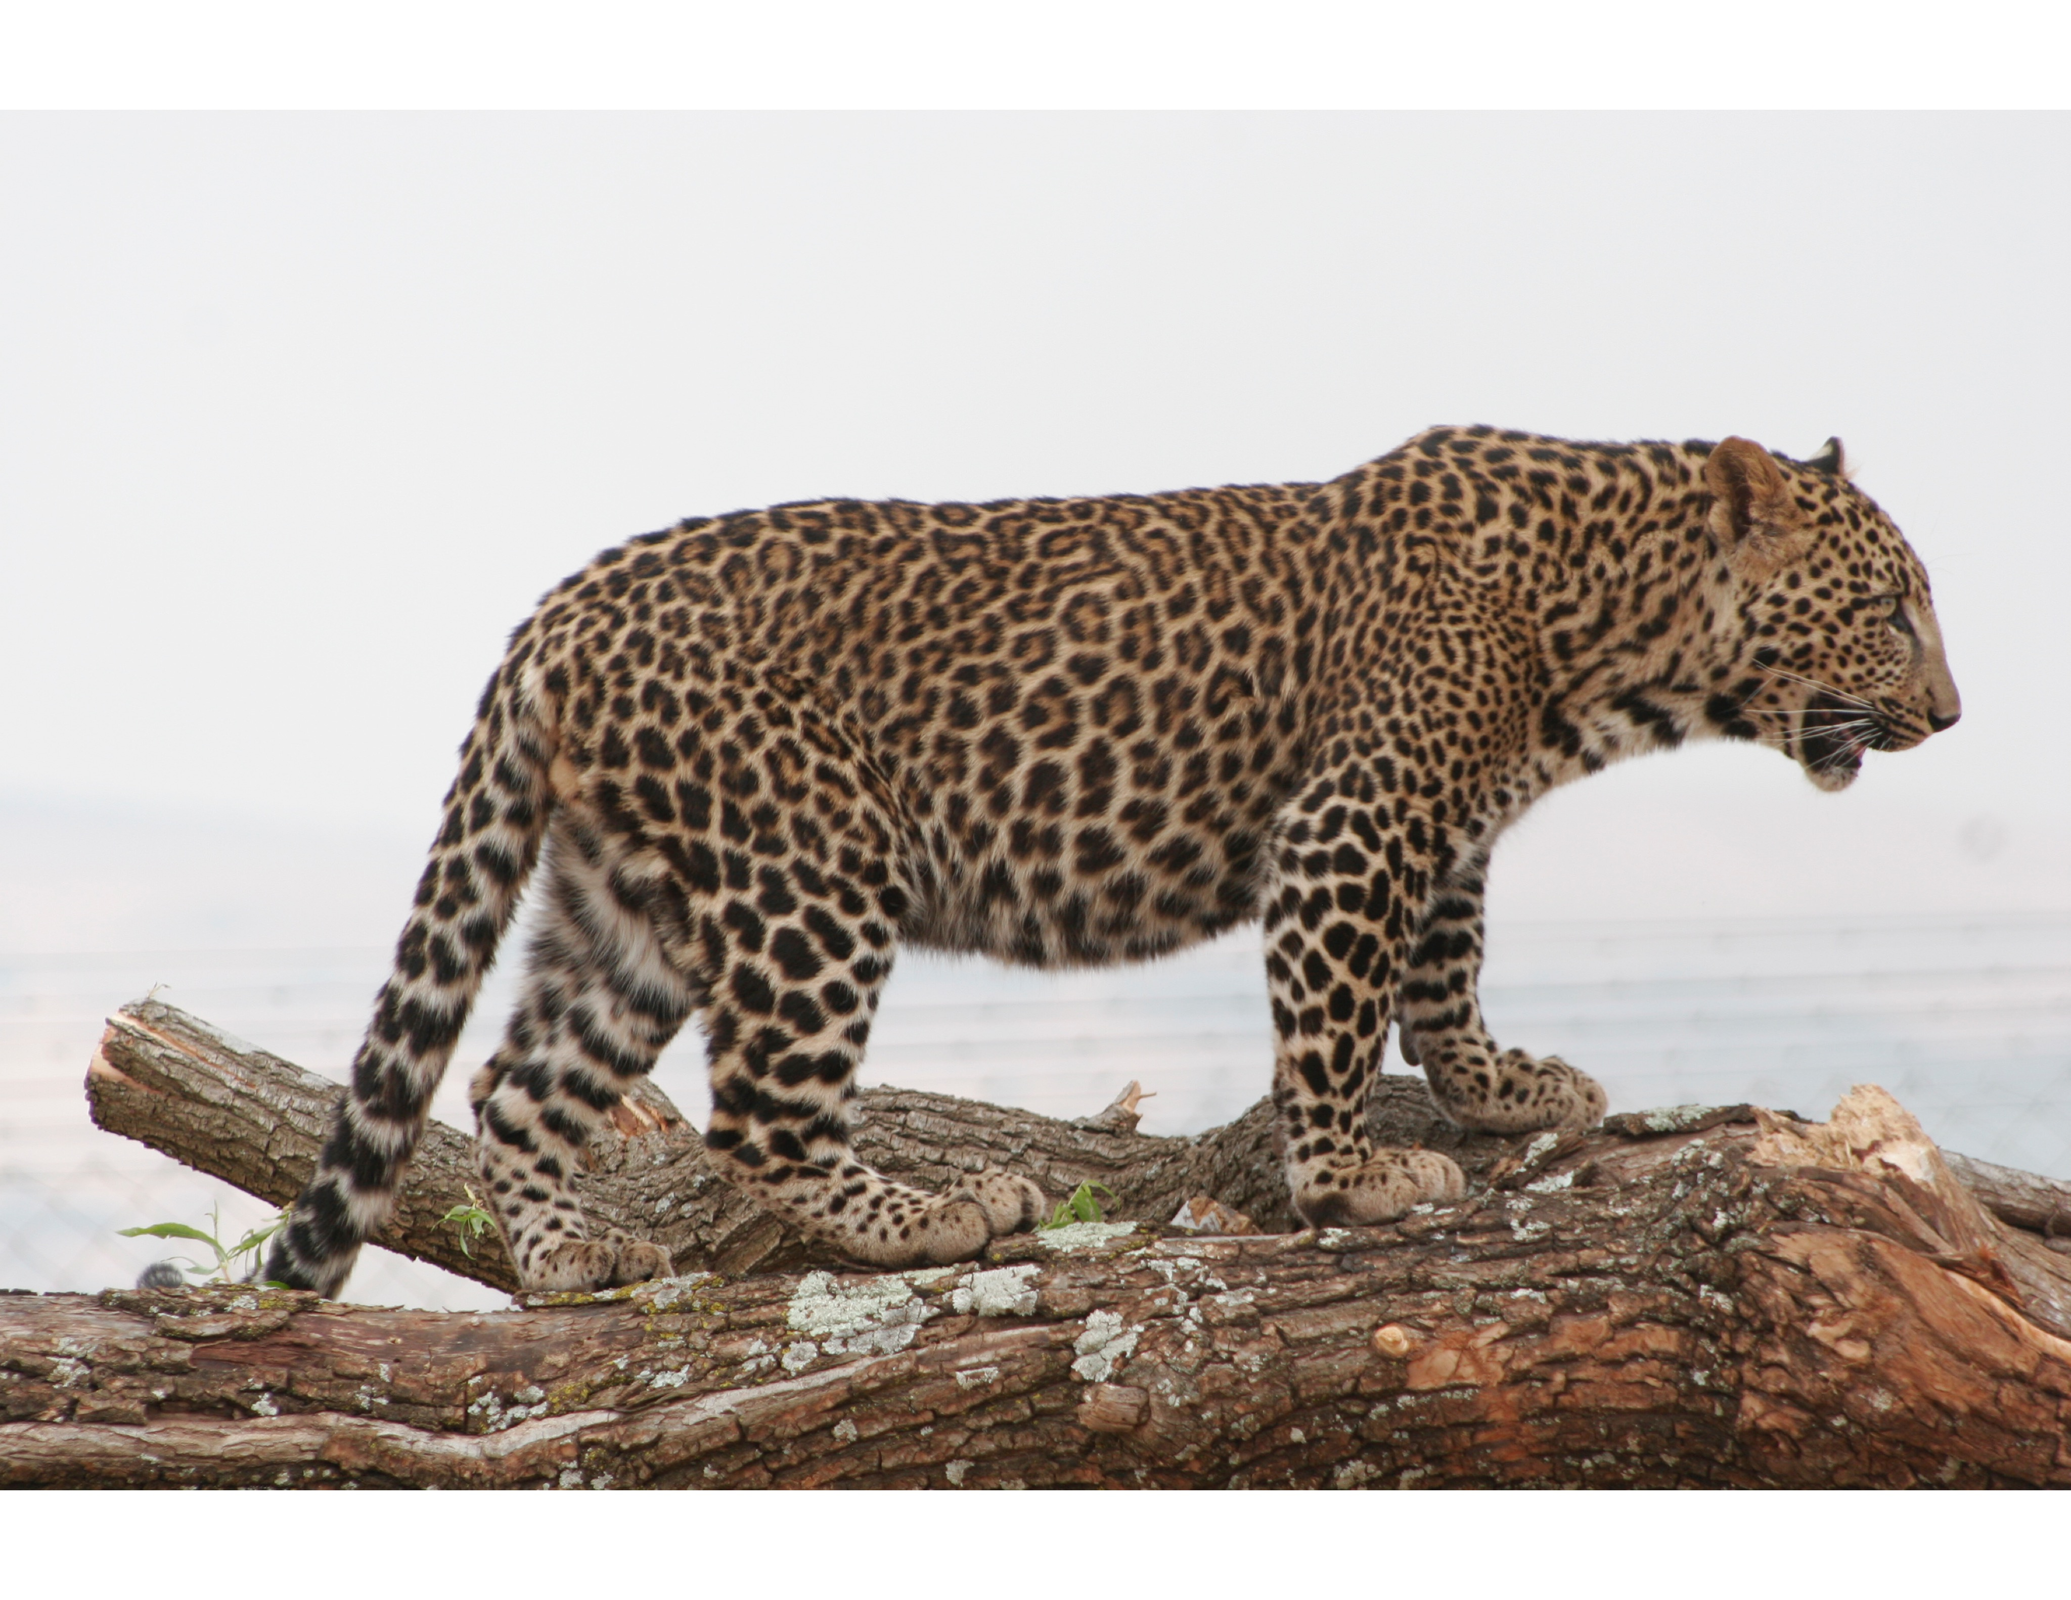

Filters
Intended Message
Message Received
Meanings
Assumptions
Beliefs
Conclusions

Slide 46
Stage 2: Understanding
Confusion Zone
or Resistance Zone
Awareness
Acceptance
Commitment
Engagement
Understanding
Emotion-filled questions
New questions asked and answered
Reflective resistance and confusion
Honest communication is key
Notes:
Help them understand:
Cost structure
Performance development
Ongoing improvement initiatives
Overall: the most important value drivers

Slide 47
Stage 3: Acceptance
Confusion Zone
or Resistance Zone
Awareness
Acceptance
Commitment
Engagement
Understanding
High Performance Zone
Revisit steps
Acceptance ≠ support
Most people stop here

Slide 48
Stage 4: Commitment
Confusion Zone
or Resistance Zone
Awareness
Acceptance
Commitment
Engagement
Understanding
Smaller part of team
Key to successful change
Thought leaders emerge
Focus on the goal
High Performance Zone
Notes:
Thought leaders are often informal leaders in the organization.

Slide 49
Stage 5: Engagement
Confusion Zone
or Resistance Zone
Awareness
Acceptance
Commitment
Engagement
Understanding
Smallest group
Key to high-performance culture
High Performance Zone
Notes:
20/60/20 story (normal distribution has 68% within 1 s.d., 95% within two s.d., and 99.73% within three s.d. of the mean)
Top drivers of engagement (per Quantum Workplace)
My job allows me to utilize my strengths
I trust our senior leaders to lead the company to future success
The senior leaders of the organization value people as their most important resource
If I contribute to the organization’s success, I know I will be recognized. (Bottom 5 in favorability)
My opinions seem to count at work.
I believe this organization will be successful in the future

Slide 50

Top Drivers of Engagement
My job allows me to utilize my strengths
I trust our senior leaders to lead the company to future success
The senior leaders of the organization value people as their most important resources
If I contribute to the organization’s success, I know I will be recognized
My opinions seem to count at work
Notes:
2017 Employee Engagement Trends Among America’s Best Places to Work
What does engaged mean? 1. Highly favorable 2. Preach organizational love 3. Plan to stay 4. Pursue extra effort (Overall for 8,700 companies and 500,000 employees at 66%)
What does contributing mean? 1. Moderately favorable 2. Hold back 3. Opportunity for increased performance (at 25%)
What does disengaged mean? 1. Indifferent 2. Lack motivation 3. At-risk for turnover (at 6.6%)
What does hostile mean? 1. Negative 2. Lack commitment 3. Impact others’ productivity (at 2.4%)
Important to note that this is from a cohort of companies that are focused on being among the Best Places to work in America
When the organization makes changes, I understand why? This was the item (out of 37 items) that had the highest amount of uncertainty at nearly 27%. Employees were neither favorable or unfavorable on this item. This is at the core of our communication as leaders and an area of improvement for the best companies and, therefore, yours.
Quantum Workplace employee engagement survey of 500,000 employees in 8,700 US organizations: Lowest favorability: When the organization makes changes, I understand why. 27% are neither favorable or unfavorable. Still time to change their minds. 68% fav. And 5% unfavorable
“If I contribute to the organization’s success, I know I will be recognized.” Top 5 driver of engagement and Bottom 5 in favorability

Slide 51
5 stages of effective communication
Confusion Zone
or Resistance Zone
Awareness
Acceptance
Commitment
Engagement
Understanding
High Performance Zone

Slide 52

The best way to persuade someone is with your ears, by listening to them.
Dean Rusk, former U.S. secretary of state
A doctor interrupts a patient presenting her symptoms after…
18 seconds!
Notes:
Quick tip: On an index card or PostIt note, write Listen! and put it on the table in front of you.

