Slide 1
Wellness: Shifting the Paradigm
Sheila Bannister, MS, CHES®, CHWC
Health and Wellness Director
EPIC Insurance Midwest
January, 2021

Slide 2
Disclaimer
The material presented here is for informational purposes only.
EPIC Insurance Midwest makes every effort to present information based on the most recent research available.
When considering wellness programming options, we recommend you consult an attorney to ensure compliance with the many rules and regulations governing employee wellness programs.

Slide 3
Learning Objectives
At the end of this presentation, attendees will be able to identify:
Definitions of wellness
Current trends in wellness
How social determinants of health impact employee health
Workplace environmental supports and policies that promote wellbeing
Community resources to partner with

Slide 4
The Struggle is Real
The COVID-19 pandemic has imposed a need for employers to think about employee wellness in ways never before imagined

Slide 5
Definitions of Wellness
Wellness Council of America
The National Wellness Institute

Slide 6
Wellness Council of America
“Wellness is the active pursuit to understand and fulfill your individual human needs - which allows you to reach a state where you are flourishing and able to realize your full potential in all aspects of life. Every person has wellness aspirations.”
“Successful workplace wellness initiatives require supporting employees in fulfilling their needs in seven areas.”
HEALTH
MEANING
SAFETY
CONNECTION
ACHIEVEMENT
GROWTH
RESILIENCY

Slide 7
National Wellness Institute
“Wellness is an active process through which people becomes aware of, and make choices toward, a more successful existence.”
“The National Wellness Institute promotes Six Dimensions of wellness. Addressing all six dimensions of wellness in our lives builds a holistic sense of wellness and fulfillment.”
EMOTIONAL
OCCUPATIONAL
PHYSICAL
SOCIAL
INTELLECTUAL
SPIRITUAL

Slide 8
Your Corporate Mission
Culture of Wellness
Environmental Supports
Policies

Slide 9
Creating a Culture of Wellness
Driven from the Top, Down
Know What Employees Want
Include Employees in the Process
Recognize Success
Evaluate and Update

Slide 10
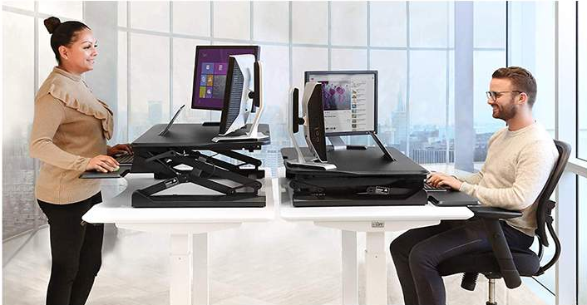
Environmental Supports
Make the Healthy Choice the Easy Choice
Onsite Fitness Facility
Active Breakrooms
Lactation Room
Relaxation Room
Walking Paths
Bike Racks
Healthy Vending Options
Healthy Cafeteria Options
Ergonomic Workstations
Accessible and Attractive Stairwells

Slide 11
Policies that Support Wellness
Benefits Package
Leave Policies
Vacation
Sick
Maternity/Paternity
Elder Care
Volunteer
Flexible Work Arrangements
Tobacco-Free Campus
Catered Food Policy
Work/Life Integration

Slide 12
Current Trends in Wellness
Mental Health
Financial Wellness

Slide 13
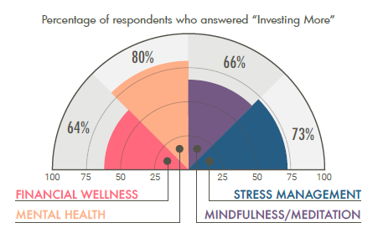
Wellable 2020 Wellness Industry Trends Report
Mental Health
Stress Management
Mindfulness/Meditation
Financial Wellness
https://blog.wellable.co/2020-employee-wellness-industry-trends-report#:~:text=Mental%20health%2C%20stress%20management%2C%20and,of%20programs%20in%202020%2C%20respectively.

Slide 14
Emotional/Mental Wellbeing
Mental Health in America
Mental Health in Indiana

Slide 15
Mental Health in America
The number of people looking for help with anxiety and depression has skyrocketed from January to September 2020:
315,220 people took the anxiety screen, a 93 percent increase over the 2019 total number of anxiety screens
534,784 people took the depression screen, a 62 percent increase over the 2019 total number of depression screens
The number of people screening with moderate to severe symptoms of depression and anxiety has continued to increase throughout 2020 and remains higher than rates prior to COVID-19. In September 2020:
The rate of moderate to severe anxiety peaked, with over 8 in 10 people who took an anxiety screen scoring with moderate to severe symptoms
Over 8 in 10 people who took a depression screen have scored with symptoms of moderate to severe depression consistently since the beginning of the pandemic in March 2020
More people are reporting frequent thoughts of suicide and self-harm than have ever been recorded in the MHA Screening program since its launch in 2014. Since the COVID-19 pandemic began to spread rapidly in March 2020:
Over 178,000 people have reported frequent suicidal ideation
37 percent of people reported having thoughts of suicide more than half or nearly every day in September 2020
People screening at risk for mental health conditions are struggling most with loneliness or isolation. From April to September 2020:
Among people who screened with moderate to severe symptoms of anxiety or depression, 70 percent reported that one of the top three things contributing to their mental health concerns was loneliness or isolation

Slide 16
Mental Health in Indiana
Indiana ranks 43rd in the nation in mental health providers with only 172.5 professionals per 100,000 population
Professionals include:
Psychiatrists
Psychologists
Licensed clinical social workers
Counselors
Marriage and family therapists
Advanced practice nurses specializing in mental health care
Providers that treat alcohol and other drug abuse

Slide 17
What You Can Do
If you have an Employee Assistance Program (EAP), promote, promote, promote it.
Remind employees through frequent communication that the EAP is available 24/7 and is completely confidential.
Let them know they have access to online resources, can connect telephonically to someone for assistance, and can even receive referrals for virtual or in-person counseling sessions.
If you do not offer an EAP, consider adding one or be sure to take advantage of the behavioral health resources provided by your insurance carrier .

Slide 18
Financial Fitness
Living Paycheck to Paycheck
Crushing Student Loan Debt
Student Loan Demographics

Slide 19
Living Paycheck to Paycheck
According to a 2017 CareerBuilder survey:
Nearly 1 in 10 workers making $100,000+ live paycheck to paycheck
28% of workers making $50,000-$99,999 usually or always live paycheck to paycheck, and 70% are in debt
More than 1 in 4 workers do not set aside any savings each month
Nearly 3 in 4 workers say they are in debt, and more than half think they always will be
More than half of minimum wage workers say they have to work more than one job to make ends meet
The survey also found that 32% of the nearly 3,500 full-time workers surveyed use a budget and only 56% save $100 or less a month.

Slide 20
Crushing Student Loan Debt
One of the contributors to the living paycheck to paycheck pitfall is the burden of crushing student loan debt.
According to educationdata.org:
The average public university student borrows $30,030 to attain a bachelor’s degree
44.7 million student borrowers are in debt by an average of $37,584 each
Federal Loans: 42.3 million borrowers each owe an average $36,520
Private Loans: 2.4 million borrowers each owe an average of $48,819

Slide 21
Student Loan Demographics
As of 2019, here is the breakdown of student loan borrowers by age:
< Age 24:
$121.2 billion
(8.2 million borrowers)
Age 25 - 34:
$501.5 billion
(15.0 million borrowers)
Age 35 - 49:
$575.5 billion
(14.1 million borrowers)
Age 50 - 61:
$241.2 billion
(6.0 million borrowers)
< Age 62:
$75.9 billion
(2.1 million borrowers)

Slide 22
What You Can Do
When it comes to employee education and support, start with the basics.
A Gallop poll revealed only 1 in 3 Americans prepare a detailed monthly budget that tracks their income and expenses.
Be sure your employees know about these technology-based applications and any others you come across in the marketplace.

Slide 23
Community Resources

Slide 24
Community Resources
National Organizations
1-800 QuitNow
American Diabetes Association
American Heart Association
American Cancer Society
National Alliance on Mental Illness (NAMI)
Wellness Organizations
Wellness Council of Indiana
Wellness Council of America
National Wellness Institute
State Resources
Indiana State Department of Health
Local Resources
Purdue Extension
Tobacco Free Coalitions
County Health Department
Chambers of Commerce
Hospitals
Community Centers

Slide 25
Social Determinants of Health

Slide 26
Your Impact
When your employees are healthy, they leave work and go home to be
better moms and dads
better grandparents
better care givers for aging parents
more active in their faith-based organizations, and
better able to serve in their communities
That’s how we change the world.

