Slide 2
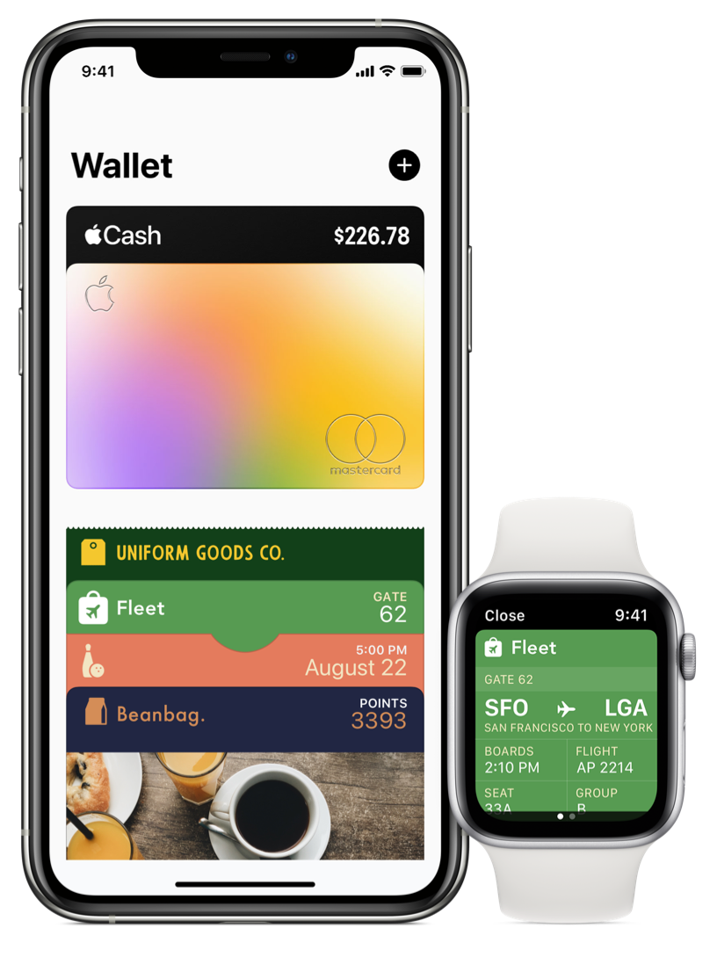

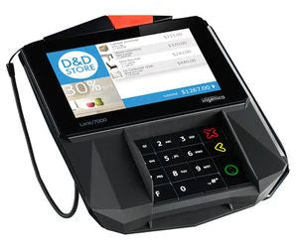
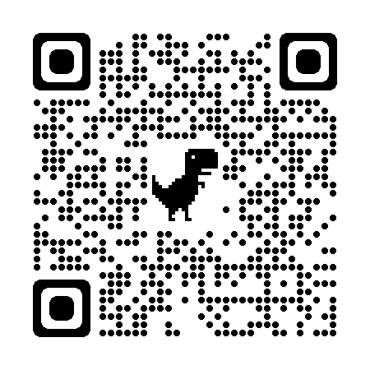
Personal Consumer Trends – Contactless Payments
Consider the path: from card to cloud
  Contactless – 4X growth last 3 years
  Virtual Payments CAGR ~20%
  Not just E-commerce; in store experiences

Slide 3




Personal Consumer Trends – Other Options
Initial rapid adoption, cooling down, and growing more slowly
Unsecured, small personal loans
These apps work great for P2P, but business adoption is more difficult.
RTP Rails – immediate bank to bank account transfers

Slide 4

Business Consumer Trends – Virtual Payments/Cards

Slide 5
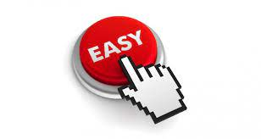


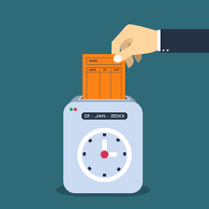

Card Acceptance for Businesses – Why & benefits
You must meet customers where they are – convenience wins more and more.
Electronic/card payments are no longer just stand alone systems – integrated payments.

Slide 6



So, what do you have to do?
Ensure you have the payment acceptance capability for the method(s) your customers want to use.
Optimize your system processes & interoperability

